Slide 1

STUDY OF CREEP OF ALUMINA-FORMING AUSTENITIC STAINLESS STEEL FOR
HIGH-TEMPERATURE ENERGY APPLICATIONS
M.S. Thesis Defense
Natalie Afonina
November 22, 2016
Notes:
Hi everyone, thank you for coming. For those of you that don’t know, my thesis is on the study of creep of alumina-forming austentiic stainless steel for high temperature energy applications. Don’t worry, I will explain what all of those words mean very soon.

Slide 2

Outline
Motivation
Background
Constant-Stress Creep Rig
Experimental Methods
Results and Discussion
Summary
Notes:
So I will start out with my personal motivation for studying materials science as well as the professional motivation for this investigation. I’ll move on to some background, then detail the design and validation of the constant-stress creep rig I built, the experimental methods employed, my results, a discussion and a conclusion to summarize it all up.

Slide 3
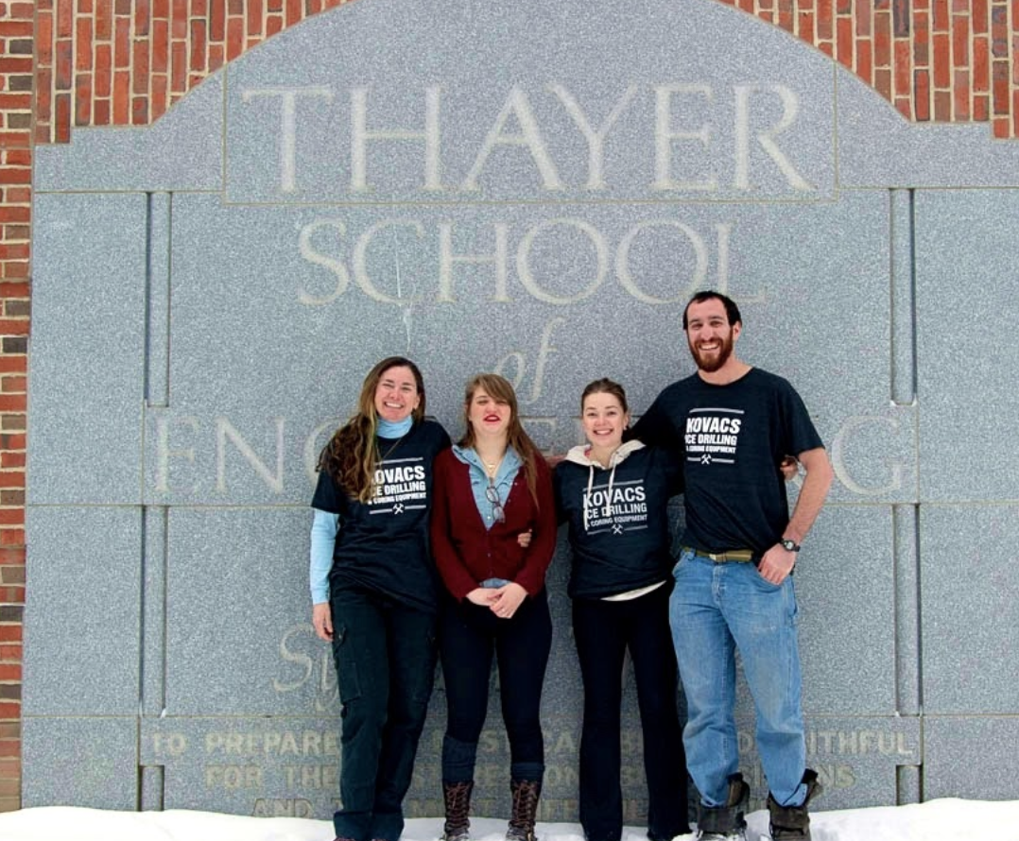
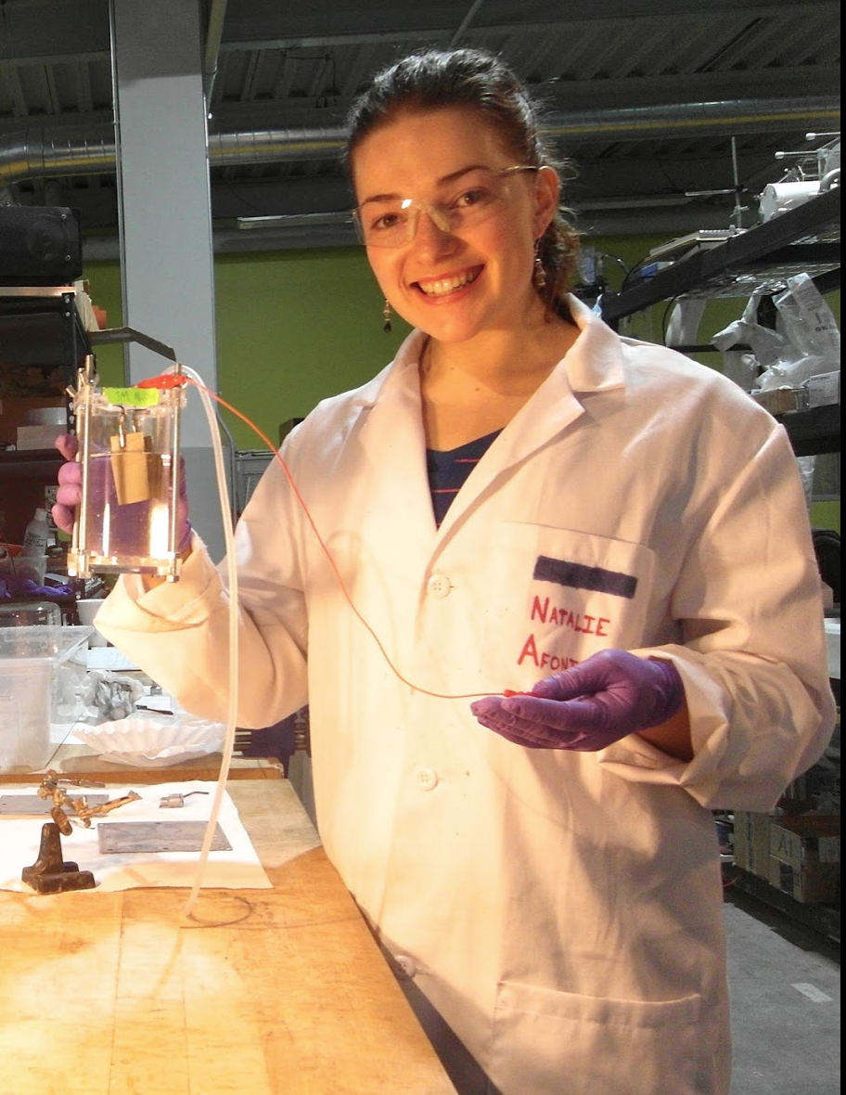
Personal Motivation
Middlebury College
B.A. Chemistry/Math
Dual-Degree Engineering Program
Open Water Power
Fuel cell and battery development startup
Thayer School of Engineering
Materials Science: metal alloys
B.E. Computer Engineering
Notes:
My personal interest in researching metal alloys can be traced back through my educational and work history.
I started off at Middlebury College as a political science major, took a year off because I wasn’t thrilled with the qualitative nature of my coursework, during which I worked on the north slope in Alaska and met structural and materials engineers working on the Trans-Alaskan Pipeline.
These interactions with professional engineers led me to transition in a 180 towards quantitative studies and applying to the Dartmouth dual-degree engineering program.
I spent my junior year at Dartmouth making use of the resources available to me and trying to figure out what kind of engineer I wanted to be by taking ENGS 24 and pursuing my ENGS21 work as an independent project.
That following year I was asked to work as an electrochemist for a fuel cell and battery development startup based in Cambridge Massachusetts. My coworkers were 4 MIT phd graduates and we worked on an aluminum-sea water reactor for underwater vehicles. After a few months I realized that my knowledgebase in both materials science and electrical engineering was lacking compared to my more educated friends and therefore decided to accept this Masters opportunity with Professor Baker working on Alumina-forming austenitic steels to deepen my knowledge in metal alloys.
At Thayer as a materials science masters student I happened to discover computer science and pursued coursework in both disciplines, eventually earning my B.E. in computer engineering last year and doing an internship at NASA programming autonomous drones. Although my path starting in political science and ending up here has been winding, I wouldn’t change anything about it.

Slide 4

Professional Motivation
Power Plants
Expensive to operate
Energy efficiency gains
Cost savings
CO₂ emission reductions
Efficiency is function of steam temperature and pressure
Elevating steam temperatures
Advanced ultrasupercritical steam boilers and turbines
Temperatures > 700°C
U.S. Department of Energy Advanced Power Systems Initiative
Notes:
Now I’m going to move on to the professional motivations for this project. Power plants are expensive to operate. By increasing their efficiencies, the cost of operating advanced power plants can be decreased and has been an ongoing process in the energy industry.
Increasing the energy conversion efficiency has the added benefit of reducting CO2 emissions as well as decreasing costs and contributing to energy savings.
The efficiency of energy conversion applications is a strong function of steam temperature and pressure, thus increases in energy efficiency can be realized by elevating operating steam temperatures and pressures. For example an increase in operating temperatures from 600°C to 800°C results in an efficiency increase of more than 10%.
Advanced ultrasupercritical steam boilers and turbines for power plants offer the promise of higher efficiencies and lower emissions and efforts are currently underway to enable advanced power plants to function at temperatures greater than 700°C and are goals of the U.S. Department of Energy’s Advanced Power Systems Initiative.

Slide 5
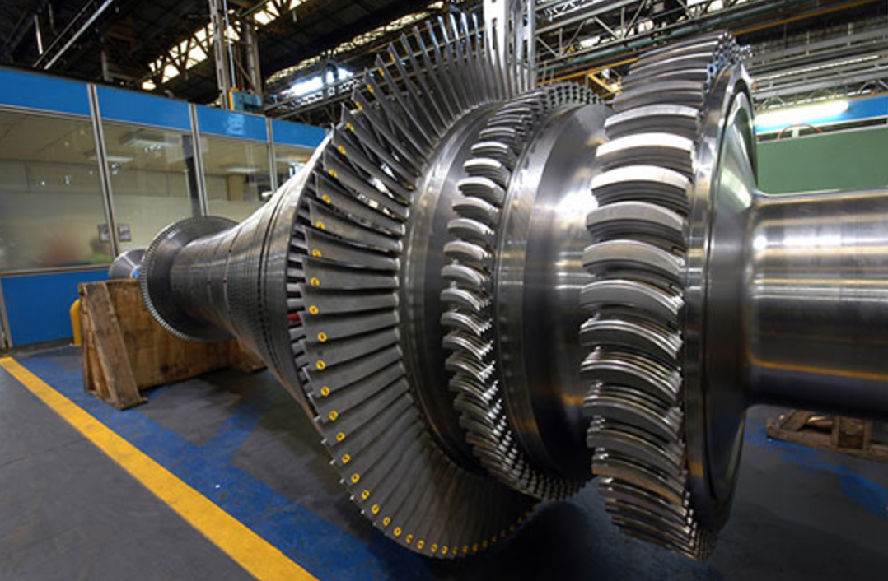
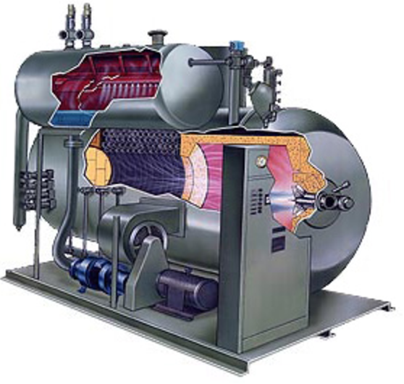
Professional Motivation
U.S. Department of Energy
700°C and 35 MPa
20% emission reduction
Aggressive environments
Material composition and properties
High-temperature creep strength
Oxidation resistance/corrosion resistance
http://site.ge-energy.com/businesses/ge_oilandgas/en/newsletter/geog_viewsandnews_072011/images/R-NP-03043-0022.jpg
Notes:
the U.S. Department of Energy has set a goal to develop materials technology needed for the construction of the critical components of coal-fired boilers and turbines that are capable of operating with steam at temperatures of 760°C and pressures of 35 MPa, which can reduce emissions, including CO2, by 20% or greater compared to today’s U.S. power plant fleet
An important contributor to realizing these higher steam temperatures and pressures is the material composition of the power plants' industrial gas turbine components, super heater tubes and boilers. Aggressive environments, where metal components are exposed to water vapor, sulfur and carbon species, are a prime target for new materials to be developed.
Metal alloys must have the necessary material properties to withstand such conditions. These properties include the materials' high-temperature long term creep strength, oxidation resistance and corrosion resistance

Slide 6
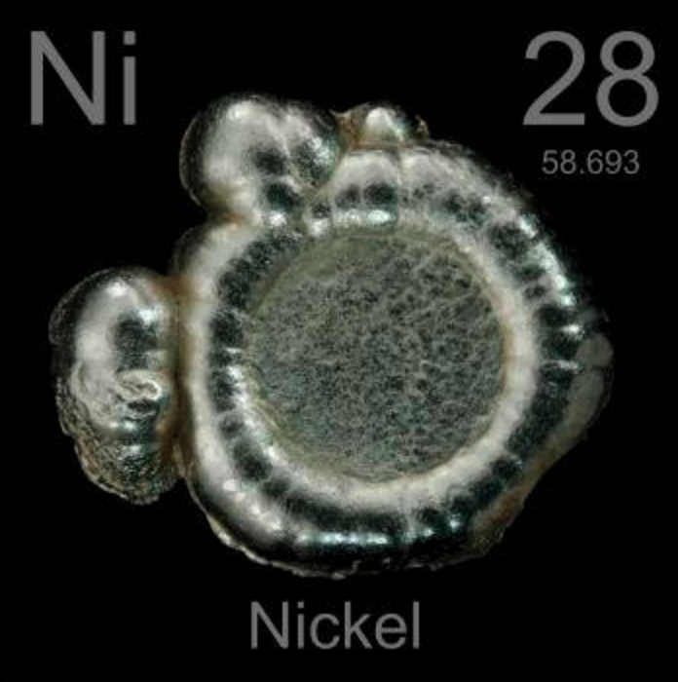
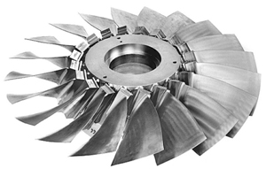
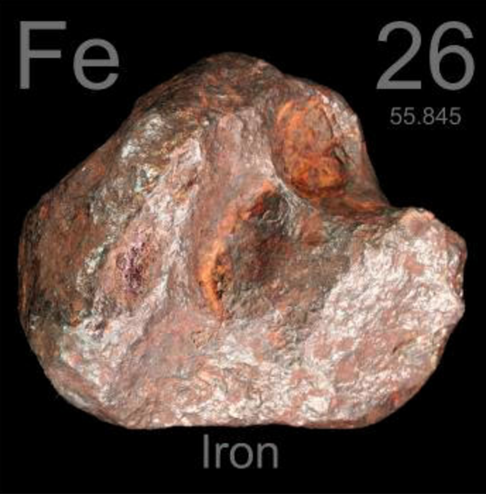
Background
Nickel-based superalloys
Not economically viable
Iron-based alloys
Lower in cost
Material properties
Alumina-Forming Austenitic Steels (AFAs)
http://www.twi-global.com/_resources/assets/inline/full/0/13635.jpg
Notes:
Nickel-based superalloys and austenitic alloys with high nickel concentrations perform well and have the necessary creep strength and oxidation and corrosion resistance to withstand such conditions, but are prohibitively expensive and not economically viable except for use in specialized applications due to nickel’s relatively high cost.
Thus, new iron-based alloys are being researched and developed that can withstand the demands of such energy conversion and combustion systems as well as to decrease reliance on costly nickel-based alloys.
One promising class of alloys that are low in cost and potentially capable of withstanding the rigors placed on the materials by high temperature energy applications are alumina-forming austenitic stainless steels
more investigation is needed into the oxidation and corrosion resistance as well as their creep strength in order for this class of steels to be widely used as an alternative to nickel-based alloys

Slide 7

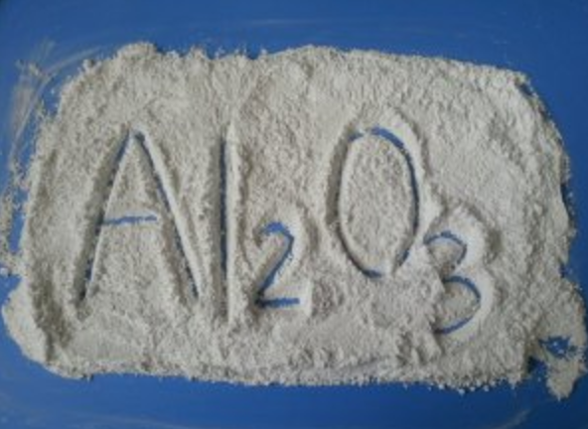
Alumina-Forming Austenitic Steels
Oak Ridge National Laboratory
Fe-(12-35)Ni-(12-15)Cr-(2.5-4)Al-(0.6–3)Nb (wt %)
Benefits of AFAs
Lower in cost
Alumina surface layer
http://www.knoxvilleoakridge.com/lib/image/thumbs/ORNL_931_300_fill.jpg
Notes:
Researchers at Oak Ridge National Laboratory have developed a new family of AFAs in the last few years that have yielded promising results for use at temperatures above 700°C in aggressive environments
These new AFAs being developed are composed of iron, nickel, chromium, aluminum and niobium with varying alloying additions to maintain a single phase austenitic matrix microstructure
Relatively small amounts of aluminum additions to austenitic steels have the ability to form the protective alumina surface layer and it’s been shown that these alumina scale formations remain stable at operating temperatures from 650-800°C making AFAs the preferred choice for use in low-cost, high-temperature structural materials

Slide 8
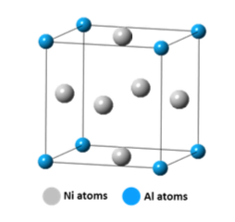
AFA precipitates
Precipitates contribute to creep strength
MC carbides
γ’-Ni₃Al (L1₂)
Fe₂Nb Laves phase
NiAl (B2)
γ’-Ni₃Al L1₂ temperature dependence
Unstable > 800°C
Present at 750°C
750°C - 800°C = unknown
http://www.twi-global.com/_resources/assets/inline/full/0/13635.jpg
Notes:
In the past, AFAs have primarily used MC carbides (with the metal primarily being niobium) or γ’-Ni3Al for their strength, with particles around~10 nm in size being effective at increasing creep strength by pinning dislocations in the f.c.c. austenitic matrix. However at temperatures above 800°C, the carbides coarsen and dissolve.
Newer grades of AFAs being developed have an austenitic face-centered-cubic instead of a body centered cubic matrix, and their elevated temperature creep resistance and strength is achieved through not only the existing carbides and L12 precipitates, but also Laves phase and NiAl-type B2 precipitates.
For the L12 Precipitates, pictured at the top, although they were found present at 750°C, they were not found at 800°C, negating the precipitates’ strengthening effects at temperatures of 800°C or greater

Slide 9
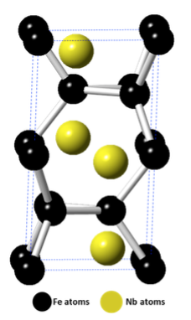
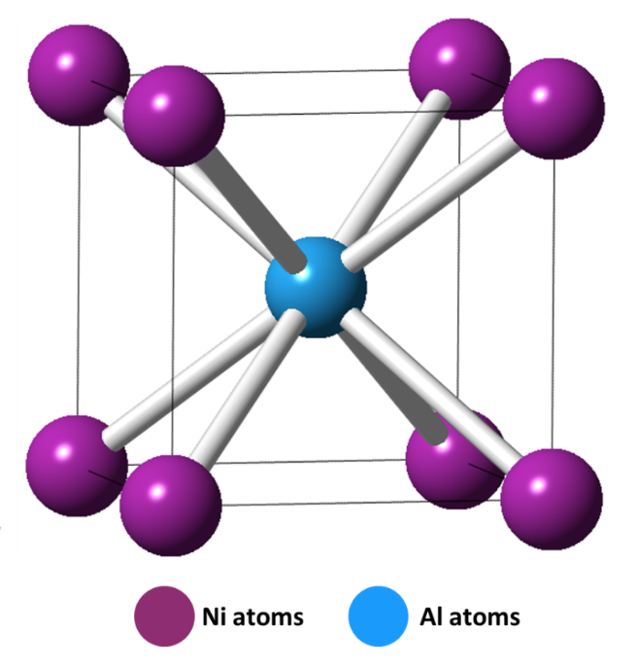
AFA creep strengthening
Fe₂Nb Laves phase
Fine dispersion diameter recommended
Pinning of dislocations
“Grain boundary precipitation strengthening”
B2-type NiAl
Fine dispersion diameter recommended
Pinning of dislocations
Notes:
Creep strengthening has been achieved in AFAs with Laves phase precipitates (the hexagonal structure pictured above) along grain boundaries and with fine dispersions of the precipitate within the austenitic iron matrix. The Laves phase precipites are stable up to 1640C, making them a good candidate for strengthening AFAs at elevated temperatures.
As the Laves phase particles increase in density and size, the brittle properties of the precipitate cause the material to lose its strength and creep resistance. Thus, a fine particle dispersion diameter of <100 nm is recommended to match the creep strength exhibited by AFAs strengthened with carbides and prevent failure of the material. The pinning of dislocations leads to an increase in the alloy’s creep strength.
Dislocations that pile up near Laves phase grain boundaries were found to be effective at suppressing local deformation by inhibiting the motion of dislocations and thereby increasing the long-term creep strength of the alloy.
This creep-strengthening mechanism was coined “grain boundary precipitation strengthening”
At elevated temperatures, B2-type NiAl precipitates (pictured below) play an important role in providing corrosion and oxidation resistance by acting as an aluminum reservoir for the formation of the alumina protective layer. They are not effective in improving the high-temperature tensile strength at temperatures greater than 400°C, however it’s been posited that B2-type NiAl precipitates improve creep resistance by either affecting the climb of dislocations in the matrix or by limiting crack propagation during creep deformation due to the precipitates’ discontinuous and granular-shape.

Slide 10
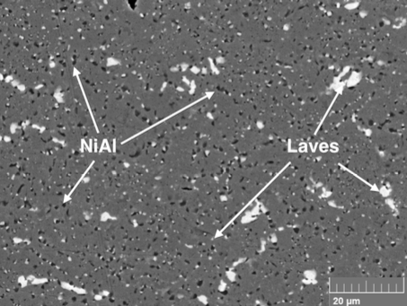
Precipitates appearance
Fe₂Nb Laves phase
Light contrast
B2-type NiAl
Dark Contrast
Notes:
This is a backscattered electron image showing the Laves phase precipitates in light contrast and B2-type NiAl phase as the dark contrast precipitates in the matrix of an AFA

Slide 11
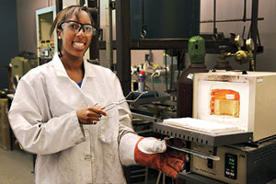
Prior Work
Dr. Geneva Trotter
Effect of aging on microstructure and mechanical behavior
Composition: Fe–20Cr–30Ni–2Nb–5Al (at%)
Single phase austenite after 1250°C solutionizing anneal
Increased B2 and Laves phase precipitation with aging
Time intervals: 0, 2.4, 24, 240, 1325 h
Study parameters chosen for continuity with prior work
Alloy composition
Heat treatment conditions
Notes:
Dr. Geneva Trotter, a graduate of Thayer School and of the Baker Lab who graduated last year, studied the effect of aging on the microstructure and mechanical behavior of the AFA alloy with the given composition
She found that the alloy was fully homogenized and presented as single phase austenite (f.c.c.) after a solutionizing anneal at 1250°C for 24 h and that there were increasing amounts of B2 and Laves phase precipitation with successively longer heat treatments at 800°C.
She conducted tests for a variety of time intervals lasting 0, 2.4, 24, 240 and 1325 h.
The alloy composition, homogenization and heat treatment conditions for this study were chosen to enable comparison with Dr. Trotter’s results and to mimic the successful temperatures and durations chosen by Dr. Trotter in her work. Heat treatments lasting a duration of 1325 h were not conducted in this investigation, because previous studies’ findings indicated that results did not differ greatly from the 240 h anneal

Slide 12
Research Project
Investigate the high-temperature strengthening mechanisms in AFAs, specifically the high temperature constant-stress creep and mechanical properties of the model alloy at different aging conditions.
Composition: Fe–20Cr–30Ni–2Nb–5Al (at%)
1250°C 24 h solutionizing anneal
Time intervals: 0, 2.4, 24, 240 h
Notes:
The purpose of this thesis was to investigate the high-temperature strengthening mechanisms in alumina-forming austenitic stainless steels, specifically the high temperature constant-stress creep and mechanical properties of the model alloy at different aging conditions.

Slide 13
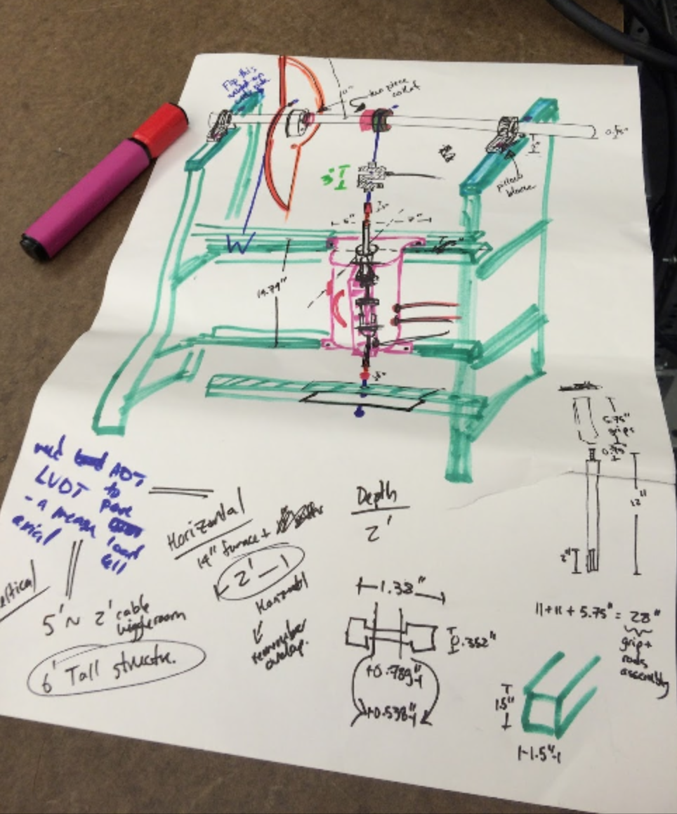
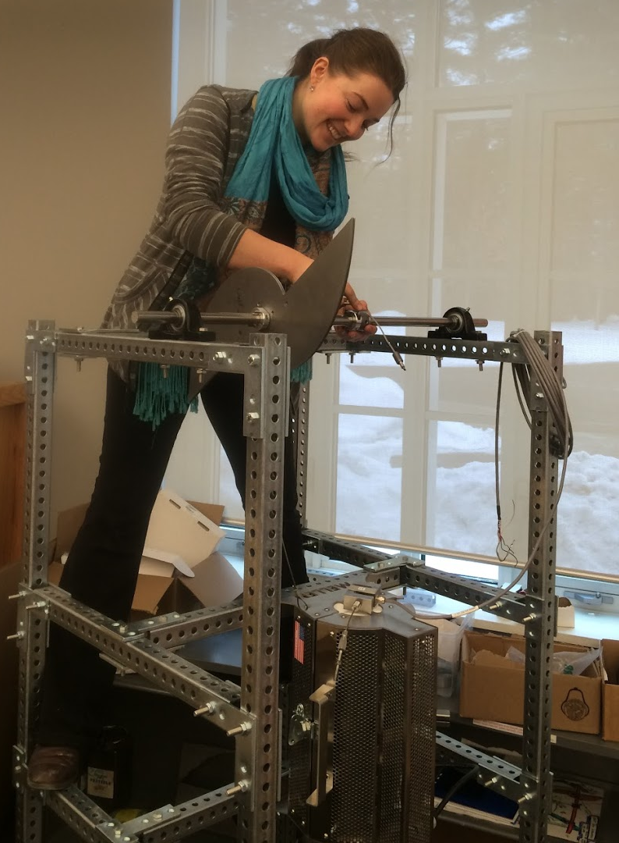
Research outline
Constant-stress creep rig
Based on Dan Breton’s prior work
Constant-stress creep tests conducted
760°C and 35 MPa
Microstructure examined
Prior to and post creep testing
Elevated temperature tensile tests
760°C for different aging conditions
Notes:
To accomplish this, a constant-stress creep rig was designed based on Dan Breton’s work, built and its operation validated
2) Samples were prepared from the model alloy and aged for time intervals of 0, 2.4, 24 or 240 h at 800°C
3) Constant-stress creep tests were conducted at elevated temperatures of 760°C at a stress of 35 MPa.
4) Secondary electron imaging and transmission electron microscopy was used to examine the microstructure of the samples prior to and after the completion of creep testing
5) Elevated temperature tensile tests were conducted on aged samples at 760°C for a variety of time intervals

Slide 14
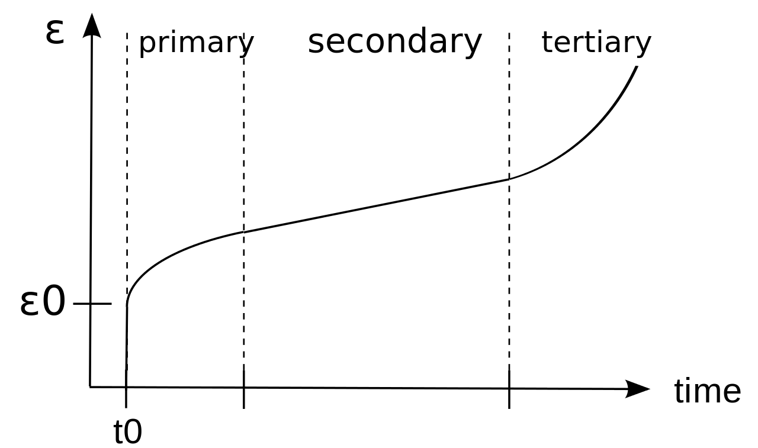
Overview of creep-testing
Creep is a time-dependent deformation mechanism
Strain accumulation
Temperature dependent
Cause for concern
Variety of testing machines
Constant-load
Variable stress
Constant-stress
https://upload.wikimedia.org/wikipedia/commons/thumb/4/4d/3StageCreep.svg/1280px-3StageCreep.svg.png
Notes:
Creep is the tendency of a solid material to deform permanently under the influence of mechanical stresses and can occur as a result of long-term exposure to high levels of stress that are below the yield strength of the material.
Creep is a time-dependent deformation mechanism where strain accumulates as a result of long-term stress and is a cause for concern for engineers when evaluating components operating under high stresses or high temperatures. For example in creep of a turbine blade used in a steam turbine, operating at high temperature may cause the blade to contact the casing, resulting in a failure of the blade.
Creep testing machines take several forms depending on what is the primary target of investigation, which includes constant load, variable stress and constant-stress rigs. A small change in the level of stress can have a large effect on strain rate affecting both the overall creep rate and microstructure of the sample. With increasing strain, the cross-sectional area of a test specimen decreases, which if tested in a constant-load creep rig, results in an increase in the instantaneous stress.

Slide 15
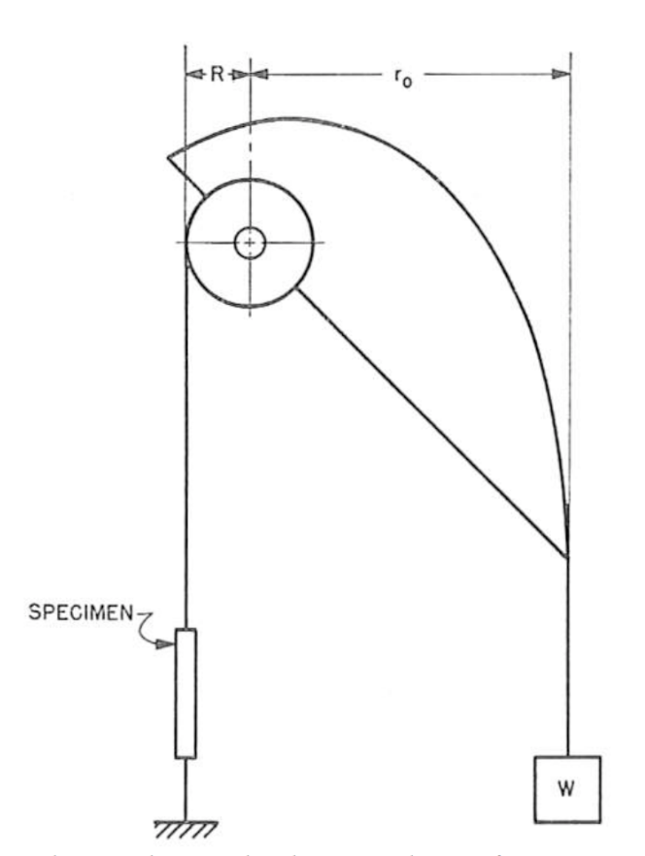
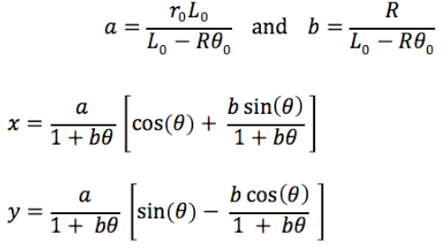
Creep-testing rig
Constant-stress rig
Isolates basic creep mechanisms
Curvature of the cam is key
Notes:
A constant-stress machine allows the stress variable to be controlled by compensating for the decrease in the specimen’s cross-sectional area by decreasing the effective load applied on the specimen. This allows the basic creep mechanisms acting on the specimens tested to be isolated and analyzed.
The curvature of the constant-stress cam is key to constructing a precise, operational constant-stress creep rig.
The curved profile is analytically calculated using a system of parametric equations. It can be derived to show that the fixed Cartesian coordinates of a constant-stress cam can be written in terms of constants a and b and the angle θ as seen on this slide.

Slide 16
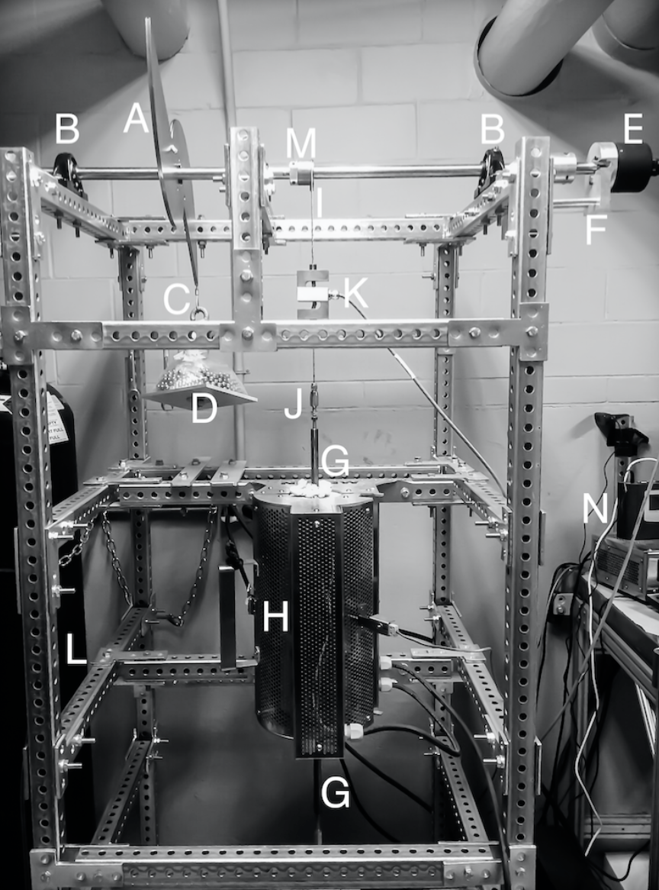
Constant-stress rig design
Main Components:
A: Cam
C: Cable attached to load
D: Load weight on tray
E: ADT
H: Furnace
K: LVDT
N: Data Logger
Notes:
This is a photograph of the full assembly of the creep rig as it is currently set up in CB13. It is designed based on a 1962 paper by Garofalo et.al and preliminary designs by Dan Breton of the grips and cam.
You’re free to go look at it later if you’re curious, although I’m warning you that it’s quite hot down there next to the boiler room and the room has been nicknamed ‘the sauna’.
The main components to note are:
Linear variable differential transformer : S-beam load cell capable of sensing accurately up to 500 lbs
The desired mechanical advantage was 8:1 in this case for an applied load of 35 MPa.

Slide 17
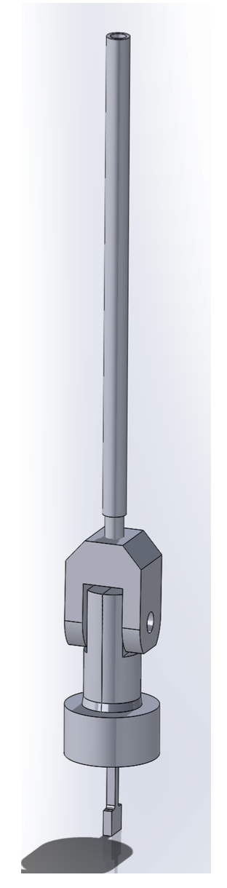
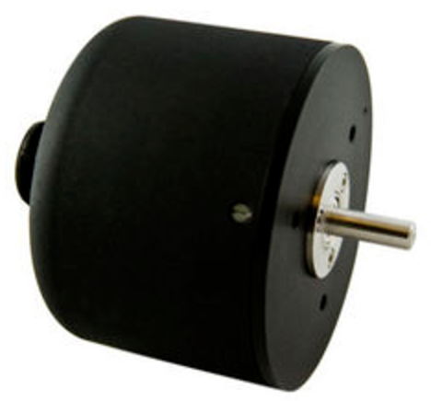
Creep rig components
Specimen grips
Vertically aligned
Made of Inconel
Angular Displacement Transducer (ADT)
Measures relative displacement
High accuracy: angular displacement of ±0.10 %
Notes:
The specimen grips and connecting rods that extend out of the furnace are fabricated from 718 Inconel to prevent elongation when heated in the furnace, and hold the specimen in a vertically aligned position. The S-beam load cell is shielded from the furnace temperature.
The ADT allows for measuring the specimen elongation by tracking the angular displacement of the cam shaft as the sample lengthens throughout the duration of a creep test. More specifically, as the specimen creeps, the relative displacement of the two specimen grips is detected by the ADT. This angular displacement is translated into an electrical signal, which is then amplified and recorded.
The high accuracy ADT used in this design is capable of measuring an angular displacement of ±0.10 %, which translates to measuring a linear displacement of <0.001 in

Slide 18
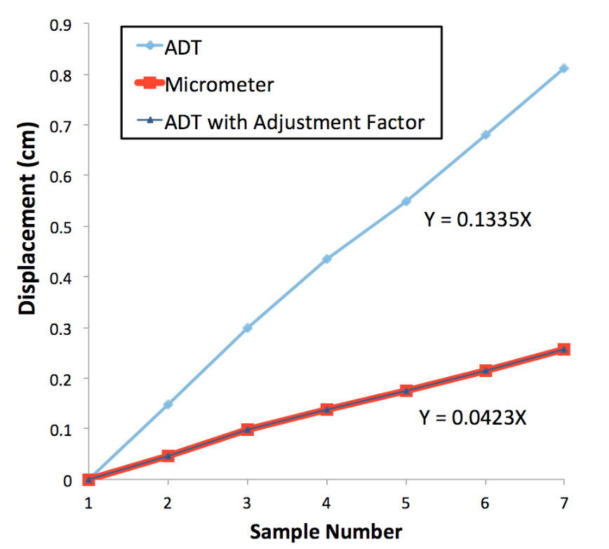
Testing and Verification
Identifying ADT adjustment factor
Rig component contributions
Temperature profile
Load calibration
Notes:
A range of tests were performed on the creep rig to verify that the system functioned as intended. The machine was calibrated for use with a load of 35 MPa, and a series of tests were conducted to prove that the load on the test sample would be reduced at the specified rate to produce a constant-stress.
The Angular Displacement Transducer output is a voltage, which is converted to an angular displacement in degrees. The ADT displacement measurements required an adjustment factor to match the actual test specimen elongation
A test was performed to determine if the connecting components of the system, such as the connecting rods, cable and grips, would creep under an applied load and affect the test results by contributing to the overall creep measured. No creep of the system components was detected for the duration of the 24 h period of the test.
A temperature profile was conducted on the vertically-aligned furnace to identify the location where the set temperature was the temperature being measured and the system adjusted accordingly.
A load calibration test was conducted and the experimental values had an average variation of 0.36 percent compared to the theoretically predicted values. This value was well within the bounds of literature values confirming the rig was calibrated and operational for constant-stress testing.

Slide 19
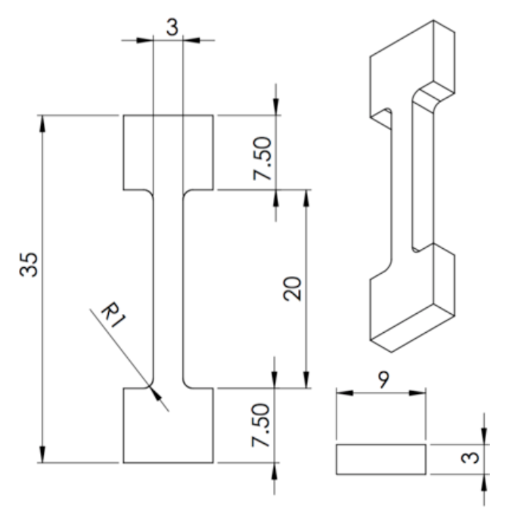
Experimental Methods
Materials preparation
Fe–20Cr–30Ni–2Nb–5Al (at%)
Sectioned and machined into T-bone shape
Heat treatments
Solutionizing anneal at 1250°C 24 h
Confirmed with SEM images
Aging at 800°C for 0, 2.4, 24 or 240 h
Notes:
A split-cast vacuum induction melting heat was used to cast the alloy into 8 kg tapered ingots by Carpenter Technology Corporation. The ingots were then press forged into rectangular bars.
In preparation for both creep testing tensile tests, the alloy was machine milled and then sectioned with a saw into the T-bone shapes necessary to insert into the specimen grips of the creep testing and tensile testing machines
Solutionizing anneals were necessary to homogenize the material for a uniform microstructure. For all tests in this study, the as-cast model alloy was homogenized for 24 h at 1250oC under vacuum and then water-quenched. This temperature and time was chosen with consideration to prior work, where it was determined that a solutionized single phase could be consistently formed. This was confirmed with SEM images of the as-cast raw material and compared with the material after a solutionizing anneal.
All heat treatments of the samples after they were homogenized were conducted at 800oC for a variety of time intervals ranging from 0 to 240h

Slide 20
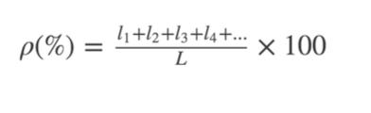
Materials characterization
Scanning Electron Microscopy (SEM)
BSE images
Quantitative analysis: ImajeJ
Bright-field Transmission Electron Microscopy (TEM)
Effect of aging temperature
Presence of γ’-Ni₃Al (L1₂)
Area fraction grain boundary coverage
Notes:
In preparation for imaging with the scanning electron microscope (SEM), samples were compression mounted and polished using successively finer silicon carbide abrasive paper
To distinguish the matrix, NiAl and Laves phase precipitates, Back-scattered electron images were used for microstructural analysis due to the strong contrast based on atomic number.
For quantitative analysis, particle density and average particle diameter were analyzed using the image processing software of ImageJ
Bright-field TEM was used to investigate the effect of aging temperature on the presence of precipitates in the alloy’s matrix, specifically on the presence of the L12 phase at 760 degrees
The area fraction of grain boundary Laves phase and NiAl precipitates (designated as ρ in the pictured equation) was quantitatively analyzed where l is the length of the grain boundary covered by Laves phase particles and NiAl precipitates and capital L is the total length of the grain boundary.

Slide 21
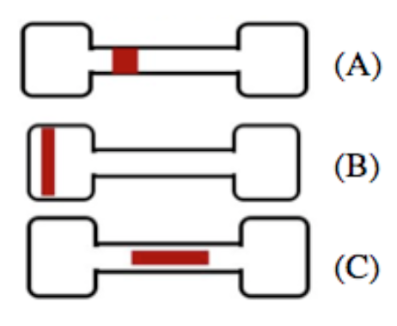
Testing
Tensile testing
Samples prepared
760°C; preload force of 50 N
Initial strain rate 5 x 10-4 s-1
Creep test experimental procedure
500 h duration for each aging condition
760°C and 35 MPa
Sectioned in three locations
Notes:
Flat T-bone test specimens were milled and polished prior to high-temperature tensile testing at 760°C. Each specimen was homogenized at 1250oC for 24 h and then aged at 800oC for a range of aging conditions. Elevated temperature tensile tests were conducted with an applied preload force of 50 N. For all tests the initial strain rate was 5 x 10-4 s-1, and up to five tensile tests were performed for each heat treatment protocol
Percent elongation of the specimen was obtained by comparing the initial specimen gauge length and measuring the specimen gauge length after the tests were completed using an optical microscope
760oC was chosen for all creep tests, because it matches the target application temperature for AFA stainless steels. Under the given test conditions it was established that the model alloy entered the secondary creep regime approximately one hour after the specimen was put into tension by loading. It would remain at a steady state for at least a 1000 h duration (the longest duration tested). To capture a representative sample of the creep curve, the duration of each test was 500 h
In the image shown, you can see the locations of where the head (B), gauge (A) and gauge-lengthwise (C) sections were located along the T-bone specimens. These three locations were chosen to explore any differences in precipitate directionality or observable microstructural differences.

Slide 22
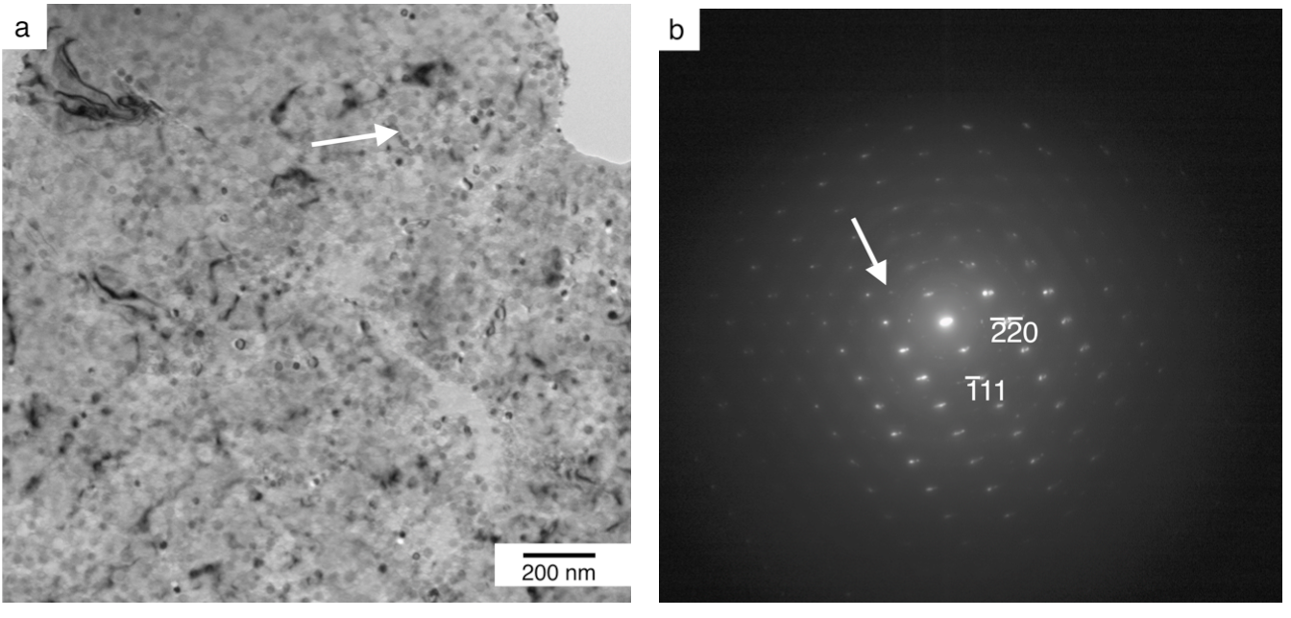
Presence of L1₂ precipitates
Investigating the presence of γ’-Ni₃Al (L1₂)
Courtesy of Margaret Wu
Notes:
A bright-field TEM image of a precipitate located on the edge of a thin foil in a sample homogenized, aged for 24 h and crept for ~800 h at 760°C is shown on the left.
A selected area diffraction pattern taken from the face centered cubic matrix is shown on the right. The strong diffraction spots are from the L12 phase precipitate superlattice reflections, and the orientation relationship between the austenite matrix and the L12 phase is cube-on-cube, mimicking results of alloys that have exhibited L12 precipitates
The current result confirms the presence of the L12 phase precipitate at 760°C, thus extending the upper bound temperature at which it has been found to be stable.

Slide 23
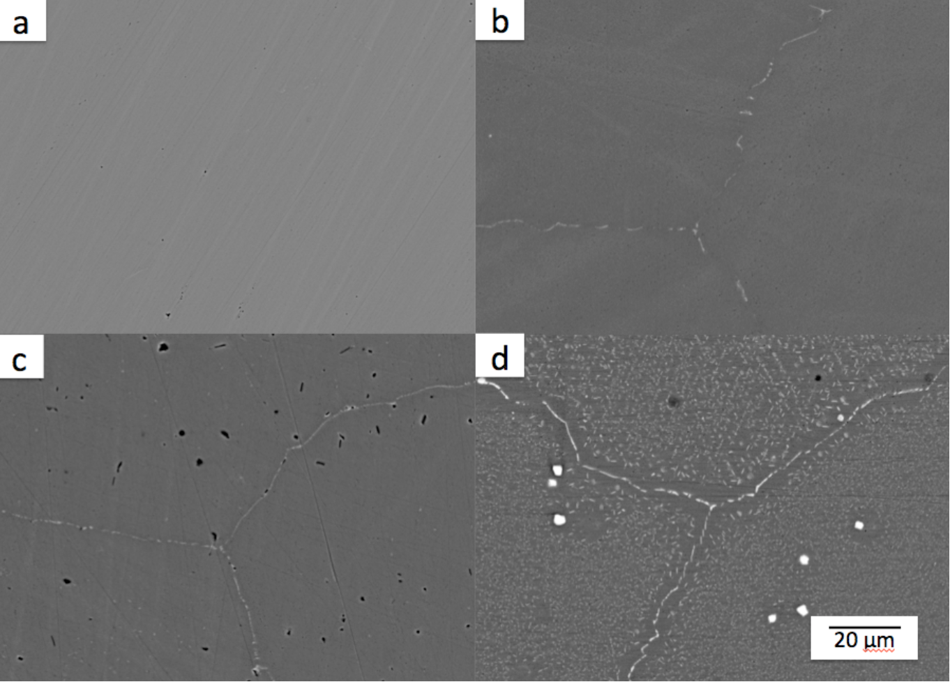
Aging time on microstructure
Notes:
These are backscattered electron images of the microstructure evolution of Laves phase precipitates after a homogenizing anneal and subsequent aging at 800°C for 2.4 h, 24 h, and 240 h respectively.
Laves phase precipitates are common in AFAs and it can be seen that after annealing at 1250°C, the alloy shows no precipitation in the single-phase f.c.c. matrix prior to aging in the top left corner. This confirmed findings by Dr. Trotter, who found no evidence of precipitation in the model alloy after a solutionizing anneal at the same temperature.
After aging the alloy exhibits increasing quantities of fine dispersions of lightly contrasted Laves phase precipitates in the SEM images. After aging for just 2.4 h, the Laves phase is present only on the grain boundaries, however after aging for 24 h and 240 h, in addition to appearing on the grain boundaries, the particles are also observed in the alloy’s austenite matrix. The Laves phase precipitates along the grain boundaries are clearly coarser than those in the interior of the grains.
In contrast to previous studies’ findings where a few darkly contrasted B2-NiAl particles were found to accompany the Laves phase precipitation on the grain boundaries after a 2.4 h heat treatment and after a 240 h anneal, the NiAl particles were larger than the Laves phase, growing at a faster rate and widespread throughout the matrix and on the grain boundaries. However in this study, no such NiAl precipitates appeared on the grain boundaries or in the matrix of the model alloy even after the 240 h heat treatment. One possible explanation for this difference may be the different stock alloys and the manufacturing methods used to fabricate each respective alloy.
A precipitate-free zone is visible adjacent to the grain boundary in the bottom right sample. Тhe presence of a PFZ in the aged samples is not surprising since the grain boundaries and matrix precipitates are made up of the same solute atoms, and a PFZ can arise either from a depletion of solute atoms proximal to the grain boundary, or from a depletion of lattice vacancies.
It was hypothesized that elimination of the PFZ may further improve the alloy’s creep properties.

Slide 24
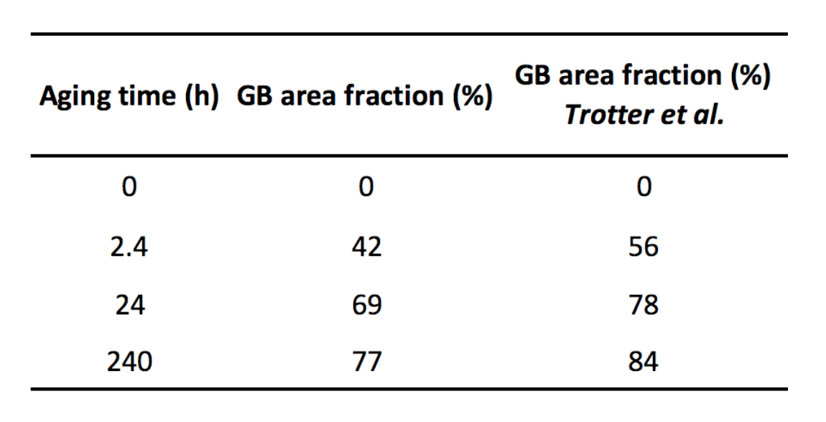
Grain boundary area fraction
Notes:
This table shows how the area fraction of grain boundary Laves phase and NiAl precipitates changes with aging time. When the sample was fully solutionized at 1250°C but not aged, there is no grain boundary coverage and the alloy is single phase austenite.
After a 2.4 h heat treatment, the grain boundary area fraction is 42%. Increasing to 69% for samples aged 24 h and increases to 77% for samples aged 240 h. These values are consistent with the upward trend in increasing grain boundary coverage found in prior work on this model alloy by Dr. Trotter shown in the right column, although she did find slightly higher percentages for all samples within ~10% of this study’s values.

Slide 25
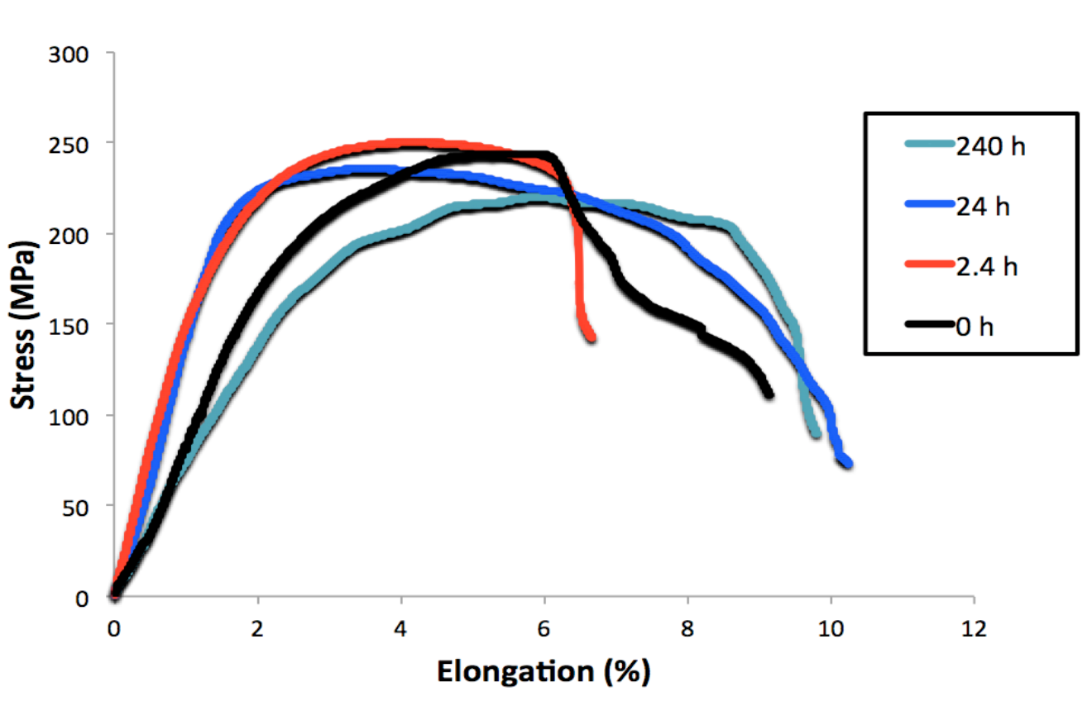
Aging time on tensile behavior
Notes:
This figure shows high temperature tensile curves conducted at 760oC with the same initial strain rate. Prior to tensile testing samples were homogenized and subsequently aged at 800°C for the time intervals indicated.

Slide 26
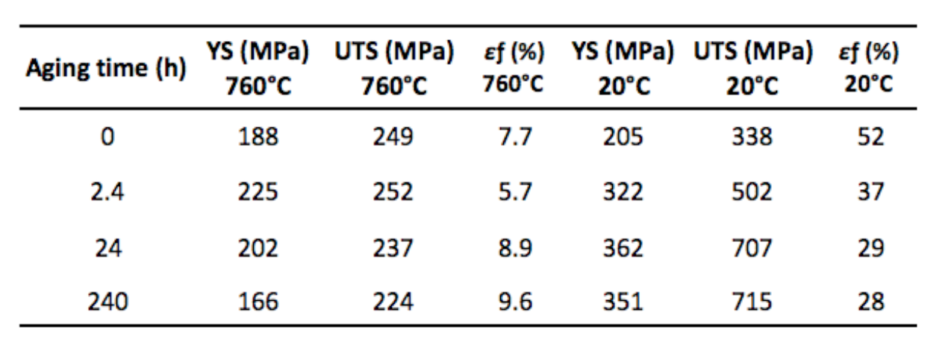
Aging time on tensile behavior
Room temperature data courtesy of Dr. Trotter
Notes:
This table provides a comparison of values from tensile tests conducted at both high temperature (on the left) and room temperature (on the right) for the average yield strength, ultimate tensile strength, and elongation to failure (εf) for the model alloy.
As demonstrated, the high temperature values were all significantly lower compared to results of tensile tests conducted at room temperature in prior studies. For the 2.4 h aged sample no discontinuities were observed in the stress-strain curves – this is in contrast to the room temperature tensile sample which exhibited an upper and lower yield point and 5% Lüder׳s strain.
Interestingly, the room temperature YS for the 2.4 h sample has the lowest value of all the heat treated samples, but has the highest value of all samples tested, including the homogenized sample, for the high temperature tests. This may be attributed to the presence of fine L12 precipitates pinning dislocations and strengthening the alloy. As the precipitates increase in size and coarsen, the strengthening decreases.
Elongations to failure were several times greater for tensile tests conducted at room temperature compared to those performed at 760oC. Whereas elongations continuously decreased with aging for room temperature tests as can be seen in the far right column, for high temperature tests, the elongation dipped two percentage points between the as-homogenized and 2.4 h aged sample and then steadily increased with aging time.

Slide 27
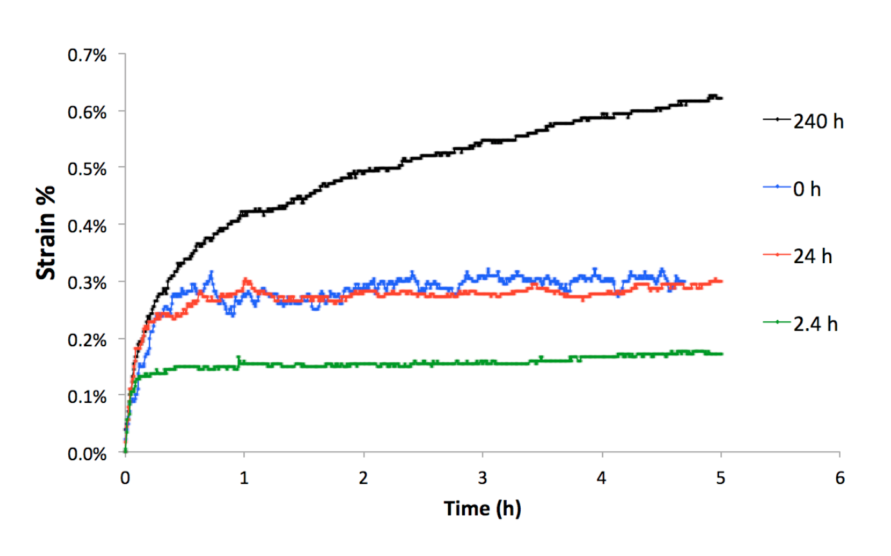
Aging time on creep properties
Notes:
Two creep tests were performed for each aging protocol. As I mentioned previously, these creep test conditions were chosen for this investigation to fall within the U.S. Department of Energy’s goal of developing materials technology needed for the construction of the critical components of coal-fired boilers and turbines that are capable of operating with steam at temperatures of 760°C and pressures of 35 MPa.
During the initial creep phase, the samples heat treated for 0 h and 24 h had similar primary creep rates (the blue and red lines), which were higher than the primary creep rate of the 2.4 h aged samples. However, they diverged in their secondary creep rate

Slide 28
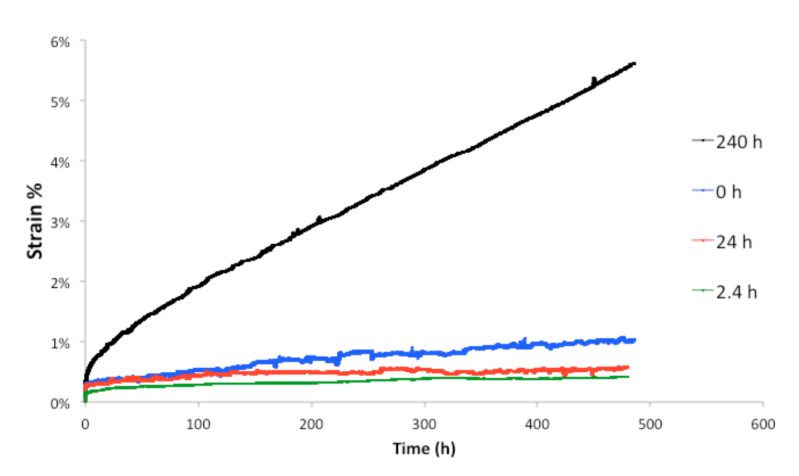
Aging time on creep properties
Notes:
With the homogenized samples exhibiting a significantly higher secondary creep rate and reaching around 1% strain at the completion of the test, while the samples aged for 24 h only reached 0.6% strain. This result is contrary to that found in prior creep studies on this alloy, which found lower creep rates for the homogenized material when compared to aged specimens as well as contrary to the suggestion that the NiAl and Laves phase don't show strong precipitation hardening at high temperatures and therefore don't contribute to creep strength.
The samples aged for 2.4 h exhibited a similar secondary creep rate to the 24 h aged samples, and the lower overall strain of 0.4% compared to the 24 h samples’ can be attributed to the lower primary creep rate. This was an unusual finding because the area fraction of grain boundary Laves phase and NiAl precipitates for the 24 h sample was significantly higher.
The samples aged for 240 h exhibited the highest primary and secondary creep rates with an overall strain reaching around 6% after 500 h. This result was unsurprising given the 77% grain boundary coverage and large size of coarsened Laves phase and NiAl precipitates evident in both the matrix and along the specimen’s grain boundaries.
Overall, the creep rates correlate well with the measured high temperature yield strengths of the alloy, with faster creep rates correlating with lower yield strengths. This result is again in contrast to prior work that found that the creep rate did not correlate well with the yield strength.

Slide 29
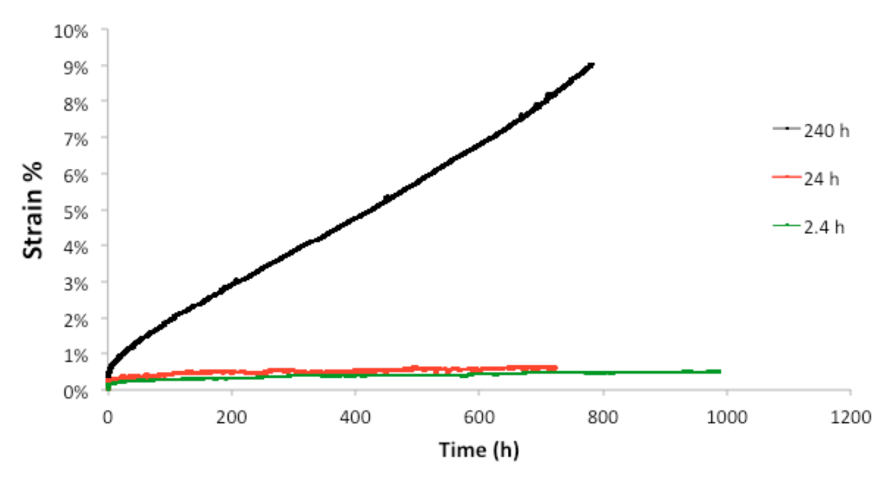
Long-term creep curves
Notes:
To begin investigating the alloy’s long-term creep properties, three constant-stress creep tests were conducted for durations lasting more than 500 h, and the resulting creep curves are shown here.
The highest strain was reached by the sample aged for 240 h, with an overall strain of around 9%. The trend of the 2.4 h and 24 h samples exhibiting a similar secondary creep rate, as seen for the first 500 h of the creep test, continued at longer time intervals of 720 h and 1000 h with the 24 h sample reaching 0.6% strain and the 2.4 h aged sample reaching 0.5% strain, respectively.

Slide 30
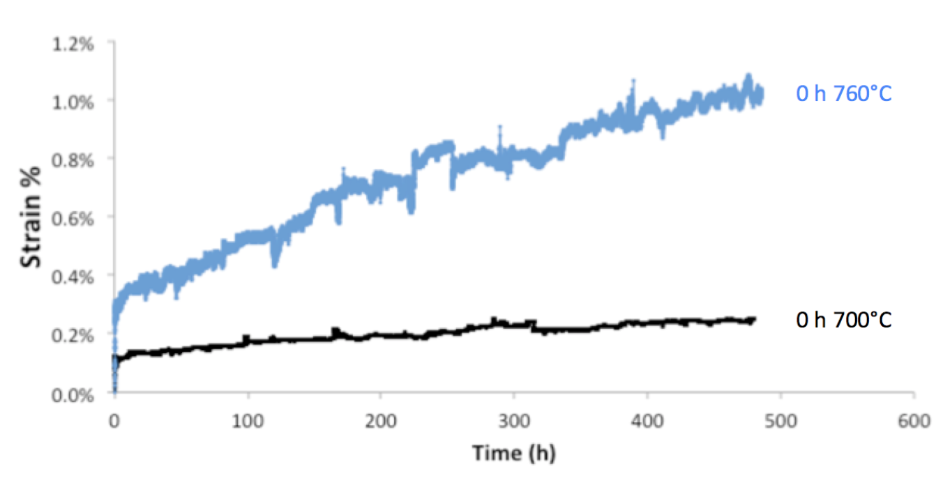
Aging temperature and creep
Notes:
To investigate how the alloy’s creep rates changed with temperature, two tests were conducted at 760°C and 700°C
The specimen creep tested at the lower temperature exhibited a significantly lower strain compared to the specimen tested at 760°C, with strains of 0.2% and 1%, respectively. This is an expected result as creep rates are temperature dependent, with high creep rates correlating with higher test temperatures.

Slide 31
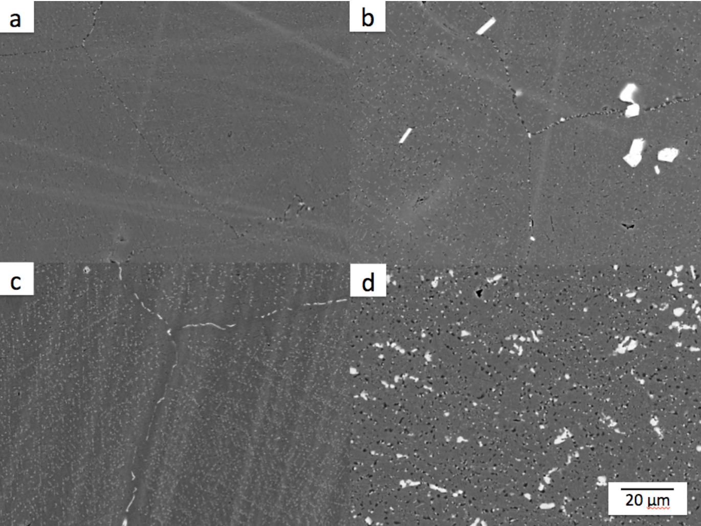
Aging & creep on microstructure
Notes:
These are backscattered electron images of the samples after 500 h of creep testing. The light contrast particles are the Laves phase which we have seen in the images prior to creep and the dark contrast particles are NiAl precipitates.
After the homogenization anneal there was no evident precipitation, but after the sample was crept, the alloy exhibits fine dispersions of Laves phase and NiAl particles in the austenite matrix and on the grain boundaries of the alloy.
As the aging time of the samples increases from 0 to 2.4, 24, and 240 h, the alloy exhibits increasing size and quantities of both the Laves phase and NiAl precipitates on the grain boundaries and in the matrix. The precipitates along the grain boundaries appear coarser than those in the interior of the grains in the matrix.
In the samples imaged prior to creep testing NiAl precipitates were either completely absent or few in number compared to the Laves phase. This is in contrast to these images of crept samples, where NiAl precipitates are present in every specimen, including the sample that was fully solutionized prior to creep. These results are not surprising given the fact that the creep testing temperature of 760°C was only 40° lower than that of the 800 degree heat treatment temperature, so continued precipitation during the creep test was expected.

Slide 32
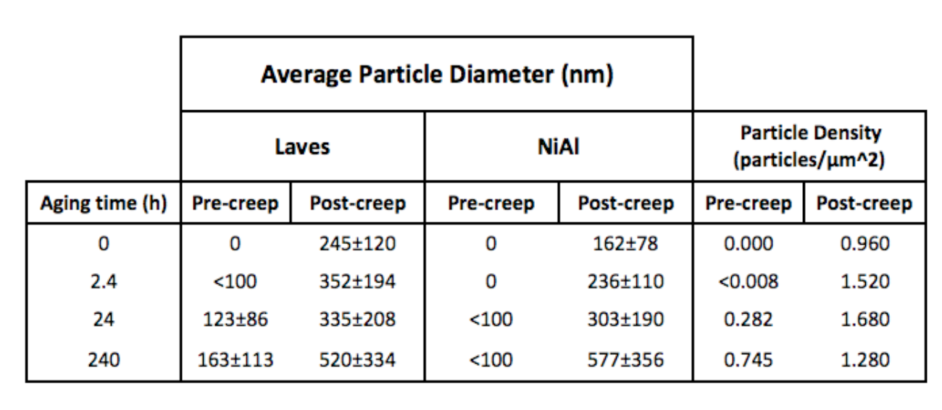
Aging and creep on microstructure
Notes:
it is evident that precipitation occurred during the 500 h long creep test
compares the average Laves and NiAl particle diameters and particle density of samples prior to and after creep testing was complete.
The density and size of precipitated Laves phase and NiAl particles increased for each aging condition throughout the duration of the creep tests of all specimens tested.
In this table you can see that the average particle diameters and particle densities were significantly higher post creep compared to pre-creep values for each respective aging condition. Particle size increased with aging time for both pre-creep and post-creep samples, with the post-creep’s particle diameter having a value more than three times greater than the pre-creep value, demonstrating significant particle growth over the course of the creep test.
Post-creep NiAl precipitates increased in size with increasing aging time, eventually catching up to and surpassing the Laves phase average particle diameter for samples aged 240 h. These results mirrors results from Dr. Trotter, where it was found that with increasing aging time, particle diameters increased for matrix and grain boundary precipitates, and that NiAl particle diameters eventually surpassed those measured of the Laves phase.
Particle densities steadily increased with aging time for all pre-creep samples. For post-creep samples, the results mirrored the trend found by Dr. Trotter, where particle densities increased for samples aged 0 h to 24 h to and then dropped for the 240 h aged sample.

Slide 33
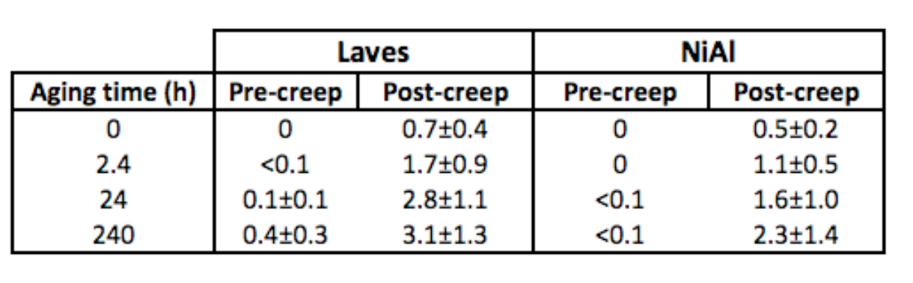
Aging and creep on microstructure
Notes:
This is a table of the volume fraction of Laves phase and Nial Precipitates for each aging condition pre and post creep. You can see that with increasing aging time the volume fraction of both Laves phase and NiAl precipitates increases, and that the volume fraction of samples post-creep is significantly higher compared to values prior to creep testing, further supporting findings that significant precipitation occurred during the creep testing process.

Slide 34
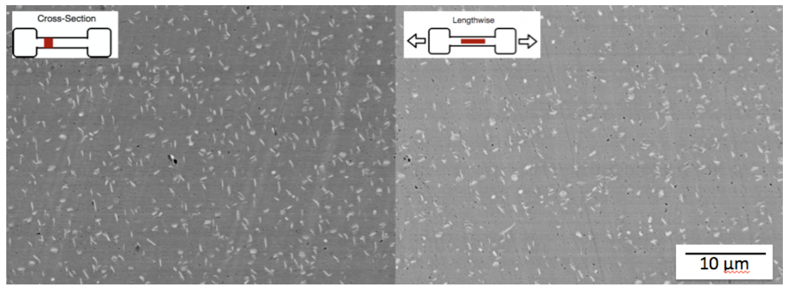
T-bone microstructure
Notes:
BSE images were taken at three locations along each T-bone for each crept specimen in order to compare precipitation properties at a location where the sample was not strained (the head) and a location where the sample was strained (the gauge) as well as lengthwise along the gauge to determine if there were directional precipitation differences. This image shows that the precipitate structure in the cross-section of the gauge evolved in a similar way to the structure lengthwise along the gauge in images taken from the same crept T-bone sample.

Slide 35
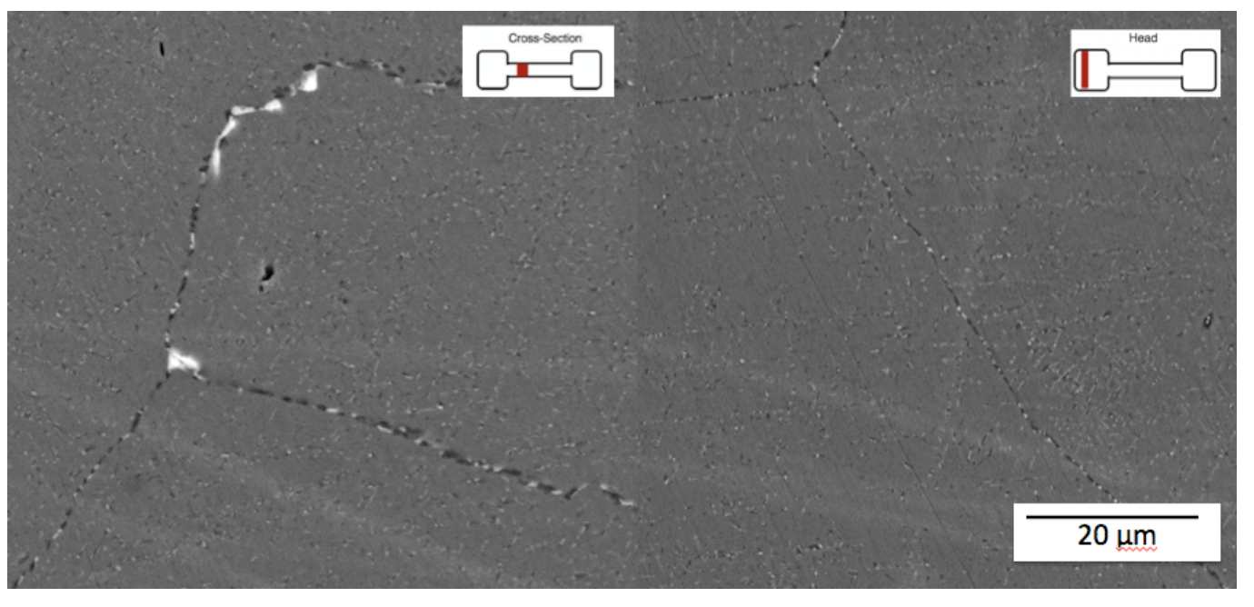
T-bone microstructure
Notes:
Here is a representative image taken from the gauge of a specimen (left), where the sample saw both the temperature and stress, and an image taken from the same T-bone sample's head (right) that saw only the temperature but not the strain.
The precipitate structure of the gauge sample that had seen the stress of the creep test was significantly different from the smaller and less coarse precipitates found in the head of the T-bone sample that had only seen the temperature but not the stress throughout the duration of the creep test.

Slide 36
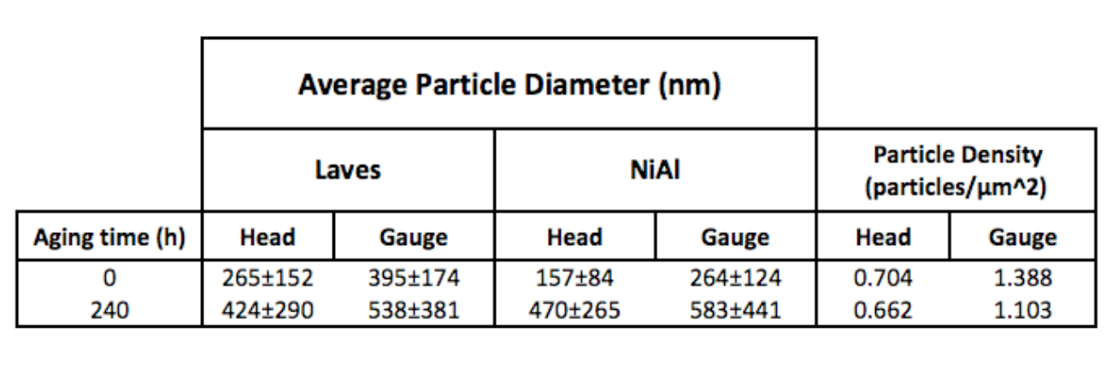
T-bone microstructure
Notes:
The data in this table supports these findings, with a significant difference in average particle diameter and particle density values between sample images taken from the head and gauge of the same crept T-bone sample. Samples taken from the gauge have an average particle diameter 100 nm greater than those values from the head, and particle density values in the gauge are over 50% higher compared to densities taken from images from the sample’s head.

Slide 37
Summary
Increased precipitation with aging time
Presence of γ’-Ni₃Al (L1₂) at 760°C
Area fraction grain boundary coverage increased with aging time
Tensile values significantly lower for room temperature results
Particle diameters and density increases with aging condition
Precipitate structure along T-bone samples
Notes:
The L12 phase precipitate was found at 760°C. The presence of L12 precipitates in aged samples could contribute to superior creep properties as the fine particles pin dislocations. Prior to this finding L12 particles had only been found at 750°C and werenot found at 800 degrees in an alloy of the same composition.
It was found that the area fraction of grain boundary Laves phase and NiAl precipitates increased with aging time, and that the high temperature tensile properties were significantly lower when compared to room temperature.
The particle diameters and particle densities of precipitated Laves phase and NiAl particles increased for each aging condition. Particle size increased with aging time for both pre-creep and post-creep samples. Particle densities increased with aging time up to 24 h and subsequently decreased for samples aged 240 h.
The precipitate structure evolved in a similar way in cross-sectional and lengthwise samples taken from the gauge of each crept sample, but samples taken from the head of the T-bone, which did not see the same stress as the gauge, had significantly smaller and less dense precipitates compared to those seen in samples taken from the gauge of the T-bone that had been exposed to the temperature and stress of the creep test.
High temperature creep rates correlated well with high temperature yield strengths of the alloy, with faster creep rates correlating with lower yield strengths.
The 700°C creep test exhibited a significantly lower creep rate compared to the higher temperature test
Overall, the alloy’s creep resistance increased with sample aging time up to 24 h compared to as-homogenized samples. Fine dispersions of both Laves phase and NiAl precipitates characterized the microstructure of samples aged for 2.4 h and 24 h with particle diameters not exceeding 350 nm. When the sample aging time was increased to 240 h, both the Laves phase and NiAl precipitates grew to particle diameters above 500 nm and the volume fraction of both precipitates significantly increased.
The creep strength of the 240 h sample decreased and was significantly worse when compared to as-homogenized specimens and those aged for shorter durations. These results are similar to findings that a decrease in the precipitate size allows for dislocations to be pinned and leads to an increase in the alloy’s creep strength. Smaller average particle diameters at or around 350 nm in size and higher particle densities for both Laves phase and NiAl precipitates should therefore be targeted to promote superior long-term creep properties in the alloy.
For all aging conditions, the microstructure continued to evolve after undergoing heat treatment throughout the duration of high temperature creep tests, signifying a need to investigate the development of alloys that can withstand the microstructural changes associated with aging for long durations at high temperatures and under load.

Slide 38

Future Work
1) Longer-term creep tests
2) Presence of γ’-Ni₃Al (L1₂) between 760°C and 800°C
3) Effect on microstructure and creep properties with addition of silicon
Notes:
Future work should be divided amongst several focus areas:
Although three longer-term constant-stress creep tests were conducted for durations above 500 h, further investigations into the alloy’s short and long-term duration creep rates and post-creep microstructural analysis is necessary to explore secondary creep properties and time to creep-rupture.
L12 particles were found in TEM images taken of samples crept at 700- 760°C, but the upper temperature bound at which Ni3Al remains stable and provides superior creep properties is yet to be determined.
The addition of silicon to AFA stainless steels up to 0.3 wt. % has been shown to improve the formation of alumina scales and stimulate precipitation of NiAl, while helping to refine and stabilize Laves phase particles
The effect of adding 0.2% silicon to the model alloy should therefore be studied to determine if NiAl precipitation is stimulated and if this addition positively affects the alloy’s creep properties and microstructure.

Slide 39


The future
Middlebury College
B.A. Chemistry/Math
Dual-Degree Engineering Program
Open Water Power
Fuel cell and battery development startup
Thayer School of Engineering
Materials Science: metal alloys
B.E. Computer Engineering
Tesla Motors
Cell Battery Engineering Group
Autonomous Systems and Data Analysis
Notes:
In terms of my future, I will be starting a 6 month co-op at tesla motors using both my programming and my materials science skills
in their cell battery engineering group starting january.

Slide 40

Acknowledgements
Professor Ian Baker and the Baker Lab Research Group
National Science Foundation
Thayer School of Engineering
My family and friends
My mother Dr. Irina Afonina
Notes:
This work would not be possible without the help and guidance of Professor Baker and the support of the Baker Research Lab Group
Thank you to the National Science Foundation for funding my research
The Thayer School of Engineering, the instrument room staff and all of the helpful people that have helped me in this endeavor throughout the years.
Thank you to Stephanie Turner for filling out so many purchase orders and keeping it all organized and Josie and Xena for pulling me out of the dark during some of those darker days.

Slide 41

Thank You
Спасибо
Notes:
A big thank you to my support network of my family and my friends, and lastly, I owe everything to my mother Dr. Irina Afonina who supported me every step of the way and without whom I wouldn’t be here today. Thank you

Slide 43
Notes:
But there are many risks involved especially with something as inconspicuous as PogoTec so our group must brainstorm ways for the user to be as obvious as possible when taking photos and video
i. LED red light goes on or flashes while taking photo/video
ii. Glasses illuminate
iii. Pictures are taken with verbal commands (these wouldn’t be loud enough for the masses, though.)
NOTES: Outline, workflow. Do an image visualization (I recommend draw.io ←-- easy to use). Step by step workflow of what it would look like to use the application.
Transition to actionable points. From millennial perspective.
Recommendations, conclusions, recommendations !!!!
VERY SPECIFIC CONCLUSIONS. BE BOLD. Use images and visuals to communicate your idea.
From a millennial perspective: this is what you have to do.

Slide 44
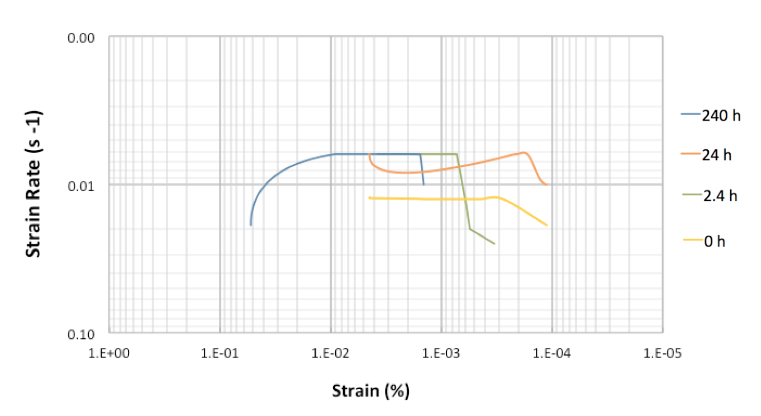
Notes:
Strain rate as a function of strain percent is plotted in Figure 4.7 for the constant- stress creep tests conducted for each aging condition. As is evident, strain rates held steady for the four aging conditions, with the 240 h and 2.4 h aged samples exhibiting an almost identical constant strain rate. The higher strain rates at the beginning of the creep tests for all samples tested can be attributed to the strain that occurs during the initial primary creep stage. The 240 h sample exhibited an increase in strain rate towards the end of the 500 h creep test.

Slide 45
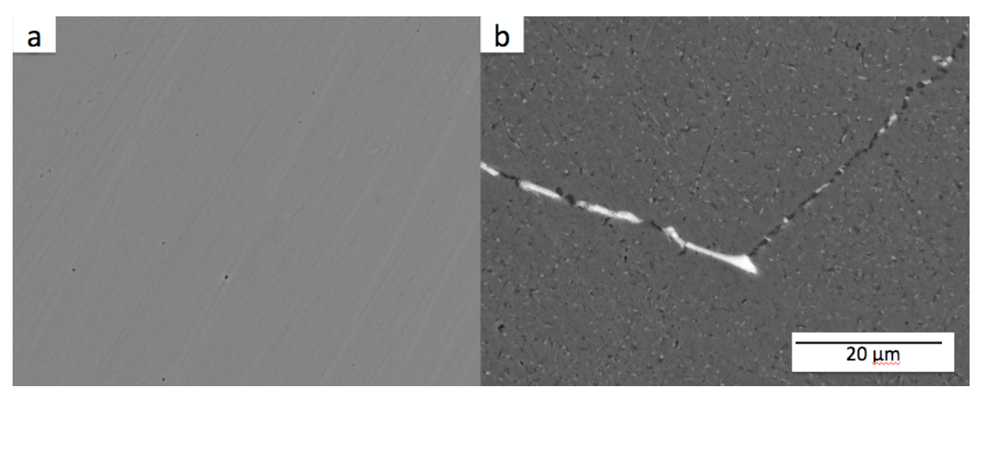
Notes:
Strain rate as a function of strain percent is plotted in Figure 4.7 for the constant- stress creep tests conducted for each aging condition. As is evident, strain rates held steady for the four aging conditions, with the 240 h and 2.4 h aged samples exhibiting an almost identical constant strain rate. The higher strain rates at the beginning of the creep tests for all samples tested can be attributed to the strain that occurs during the initial primary creep stage. The 240 h sample exhibited an increase in strain rate towards the end of the 500 h creep test.

Slide 46
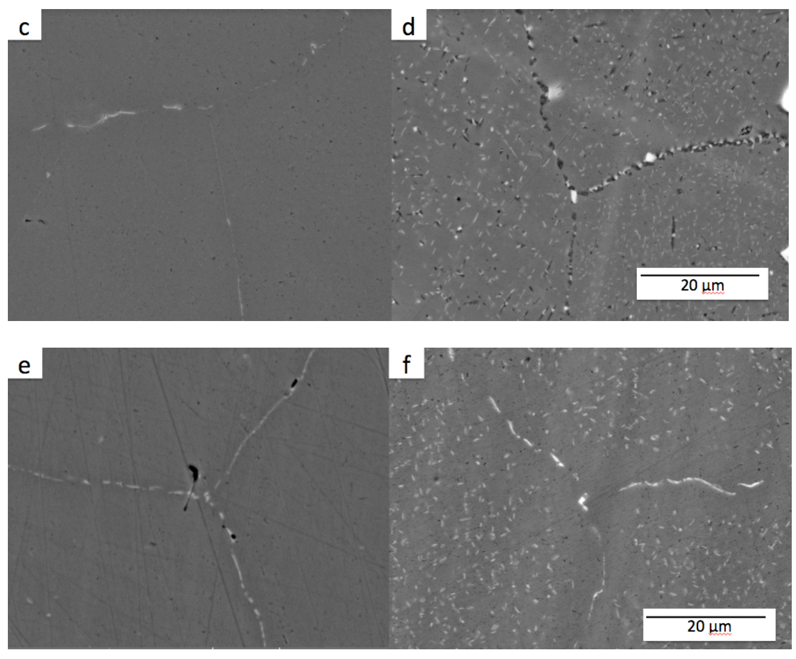
Notes:
Strain rate as a function of strain percent is plotted in Figure 4.7 for the constant- stress creep tests conducted for each aging condition. As is evident, strain rates held steady for the four aging conditions, with the 240 h and 2.4 h aged samples exhibiting an almost identical constant strain rate. The higher strain rates at the beginning of the creep tests for all samples tested can be attributed to the strain that occurs during the initial primary creep stage. The 240 h sample exhibited an increase in strain rate towards the end of the 500 h creep test.

Slide 47
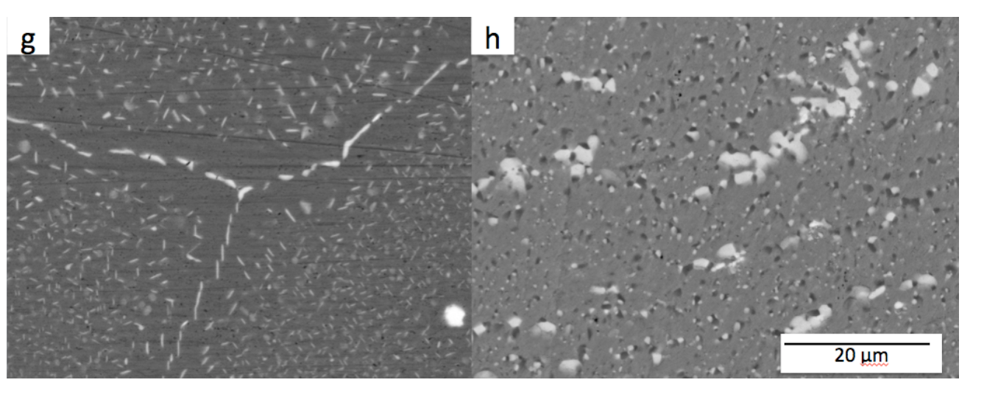
Notes:
Strain rate as a function of strain percent is plotted in Figure 4.7 for the constant- stress creep tests conducted for each aging condition. As is evident, strain rates held steady for the four aging conditions, with the 240 h and 2.4 h aged samples exhibiting an almost identical constant strain rate. The higher strain rates at the beginning of the creep tests for all samples tested can be attributed to the strain that occurs during the initial primary creep stage. The 240 h sample exhibited an increase in strain rate towards the end of the 500 h creep test.

Slide 48
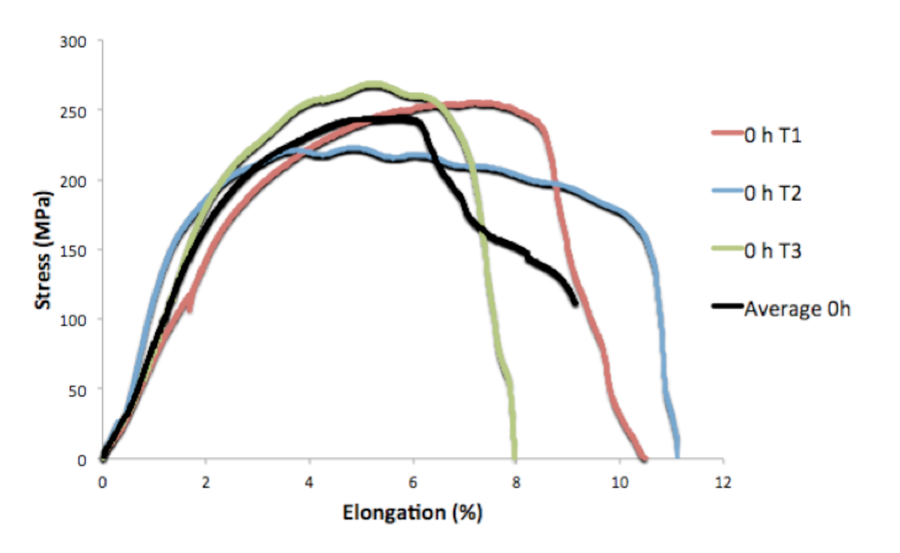
Notes:
Strain rate as a function of strain percent is plotted in Figure 4.7 for the constant- stress creep tests conducted for each aging condition. As is evident, strain rates held steady for the four aging conditions, with the 240 h and 2.4 h aged samples exhibiting an almost identical constant strain rate. The higher strain rates at the beginning of the creep tests for all samples tested can be attributed to the strain that occurs during the initial primary creep stage. The 240 h sample exhibited an increase in strain rate towards the end of the 500 h creep test.

Slide 49
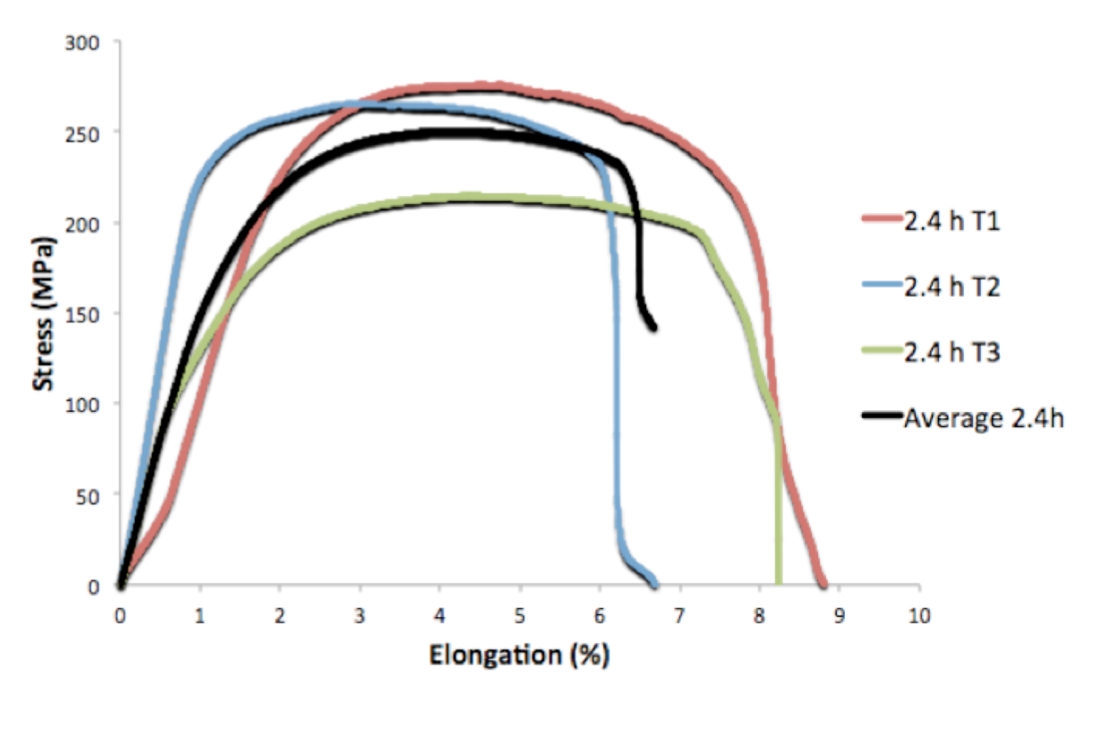
Notes:
Strain rate as a function of strain percent is plotted in Figure 4.7 for the constant- stress creep tests conducted for each aging condition. As is evident, strain rates held steady for the four aging conditions, with the 240 h and 2.4 h aged samples exhibiting an almost identical constant strain rate. The higher strain rates at the beginning of the creep tests for all samples tested can be attributed to the strain that occurs during the initial primary creep stage. The 240 h sample exhibited an increase in strain rate towards the end of the 500 h creep test.

Slide 50
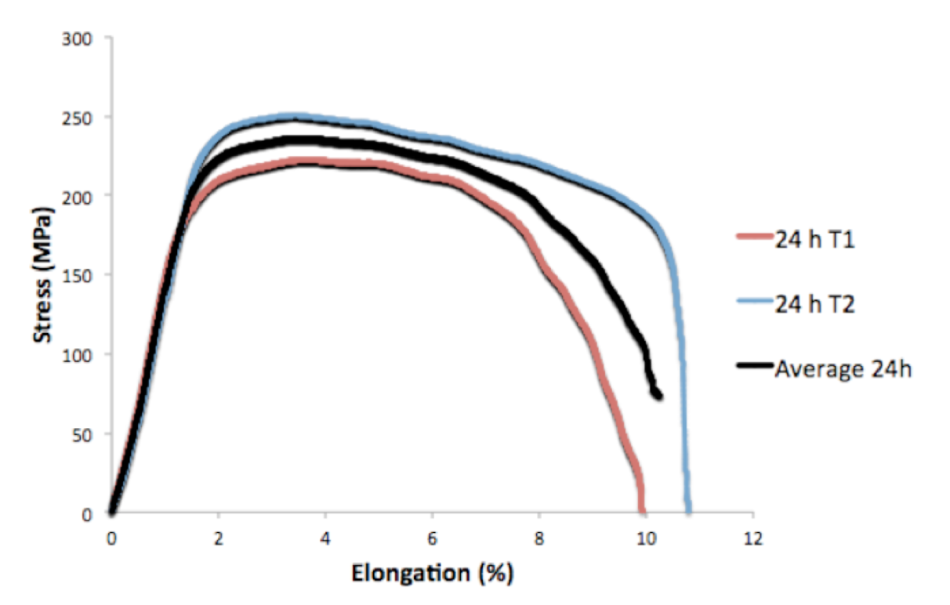
Notes:
Strain rate as a function of strain percent is plotted in Figure 4.7 for the constant- stress creep tests conducted for each aging condition. As is evident, strain rates held steady for the four aging conditions, with the 240 h and 2.4 h aged samples exhibiting an almost identical constant strain rate. The higher strain rates at the beginning of the creep tests for all samples tested can be attributed to the strain that occurs during the initial primary creep stage. The 240 h sample exhibited an increase in strain rate towards the end of the 500 h creep test.

Slide 51
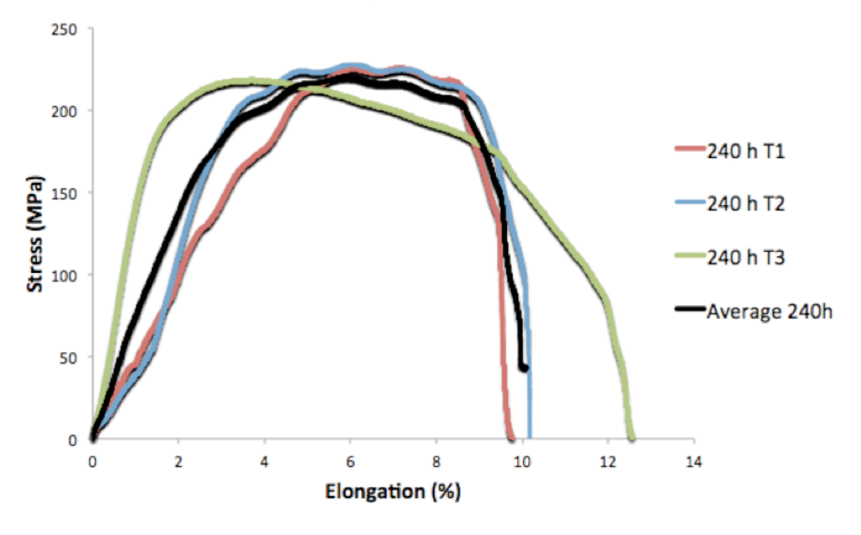
Notes:
Strain rate as a function of strain percent is plotted in Figure 4.7 for the constant- stress creep tests conducted for each aging condition. As is evident, strain rates held steady for the four aging conditions, with the 240 h and 2.4 h aged samples exhibiting an almost identical constant strain rate. The higher strain rates at the beginning of the creep tests for all samples tested can be attributed to the strain that occurs during the initial primary creep stage. The 240 h sample exhibited an increase in strain rate towards the end of the 500 h creep test.

Slide 52
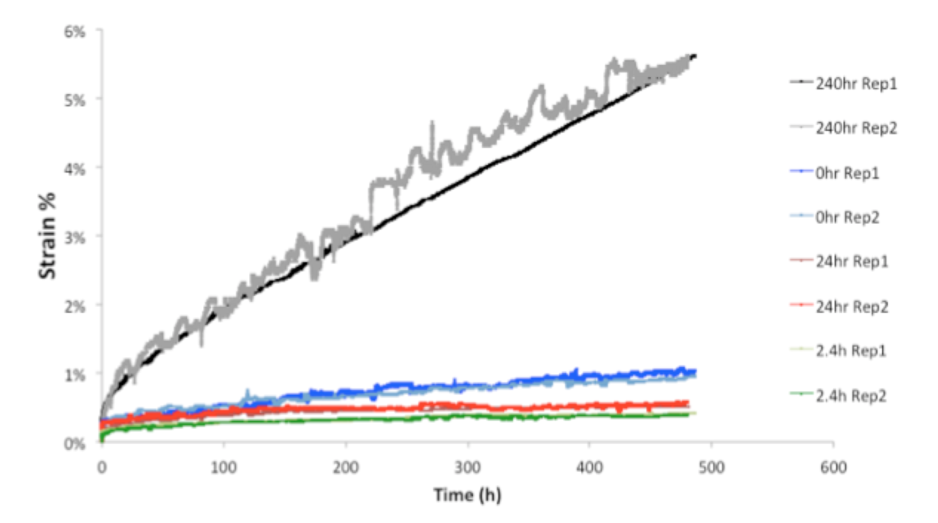
Notes:
Strain rate as a function of strain percent is plotted in Figure 4.7 for the constant- stress creep tests conducted for each aging condition. As is evident, strain rates held steady for the four aging conditions, with the 240 h and 2.4 h aged samples exhibiting an almost identical constant strain rate. The higher strain rates at the beginning of the creep tests for all samples tested can be attributed to the strain that occurs during the initial primary creep stage. The 240 h sample exhibited an increase in strain rate towards the end of the 500 h creep test.

Slide 53
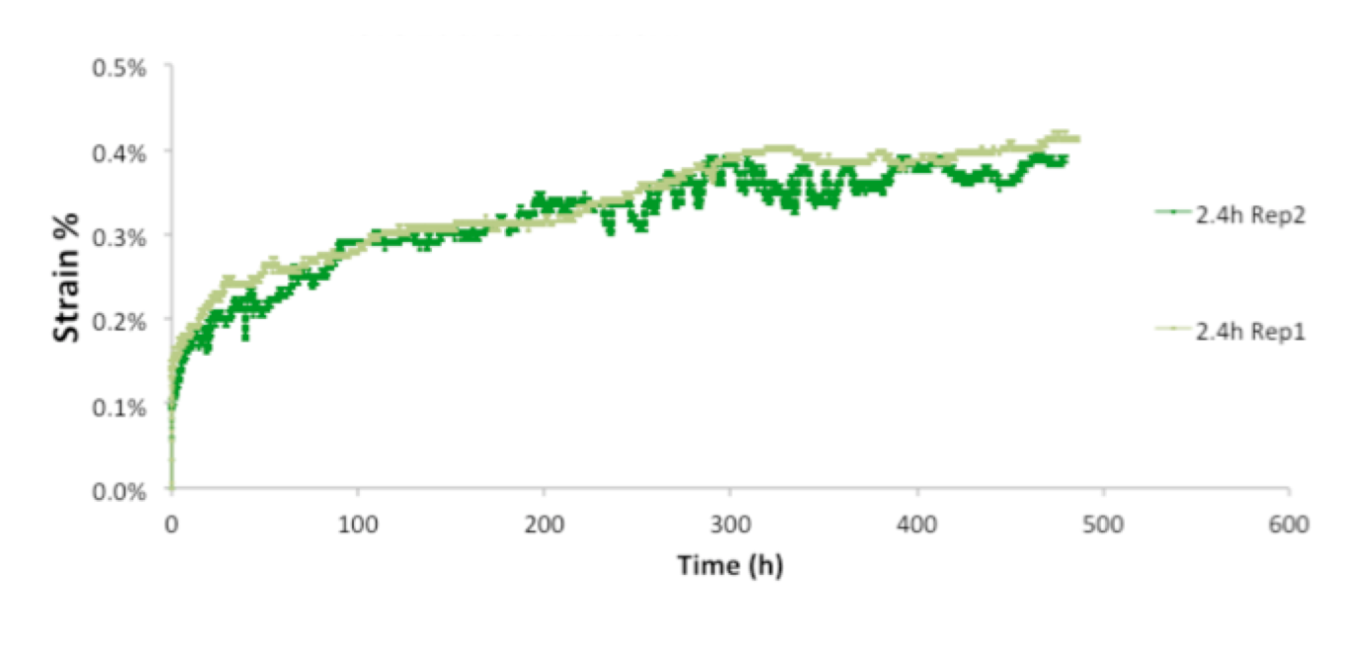
Notes:
Strain rate as a function of strain percent is plotted in Figure 4.7 for the constant- stress creep tests conducted for each aging condition. As is evident, strain rates held steady for the four aging conditions, with the 240 h and 2.4 h aged samples exhibiting an almost identical constant strain rate. The higher strain rates at the beginning of the creep tests for all samples tested can be attributed to the strain that occurs during the initial primary creep stage. The 240 h sample exhibited an increase in strain rate towards the end of the 500 h creep test.

Slide 54

Notes:
Strain rate as a function of strain percent is plotted in Figure 4.7 for the constant- stress creep tests conducted for each aging condition. As is evident, strain rates held steady for the four aging conditions, with the 240 h and 2.4 h aged samples exhibiting an almost identical constant strain rate. The higher strain rates at the beginning of the creep tests for all samples tested can be attributed to the strain that occurs during the initial primary creep stage. The 240 h sample exhibited an increase in strain rate towards the end of the 500 h creep test.

Slide 55

Notes:
Strain rate as a function of strain percent is plotted in Figure 4.7 for the constant- stress creep tests conducted for each aging condition. As is evident, strain rates held steady for the four aging conditions, with the 240 h and 2.4 h aged samples exhibiting an almost identical constant strain rate. The higher strain rates at the beginning of the creep tests for all samples tested can be attributed to the strain that occurs during the initial primary creep stage. The 240 h sample exhibited an increase in strain rate towards the end of the 500 h creep test.

Slide 56

Notes:
Strain rate as a function of strain percent is plotted in Figure 4.7 for the constant- stress creep tests conducted for each aging condition. As is evident, strain rates held steady for the four aging conditions, with the 240 h and 2.4 h aged samples exhibiting an almost identical constant strain rate. The higher strain rates at the beginning of the creep tests for all samples tested can be attributed to the strain that occurs during the initial primary creep stage. The 240 h sample exhibited an increase in strain rate towards the end of the 500 h creep test.

